Slide 1
Simulation results
08/08/2020, Milano
Alessio Russo
Carmelo Valore

Slide 2
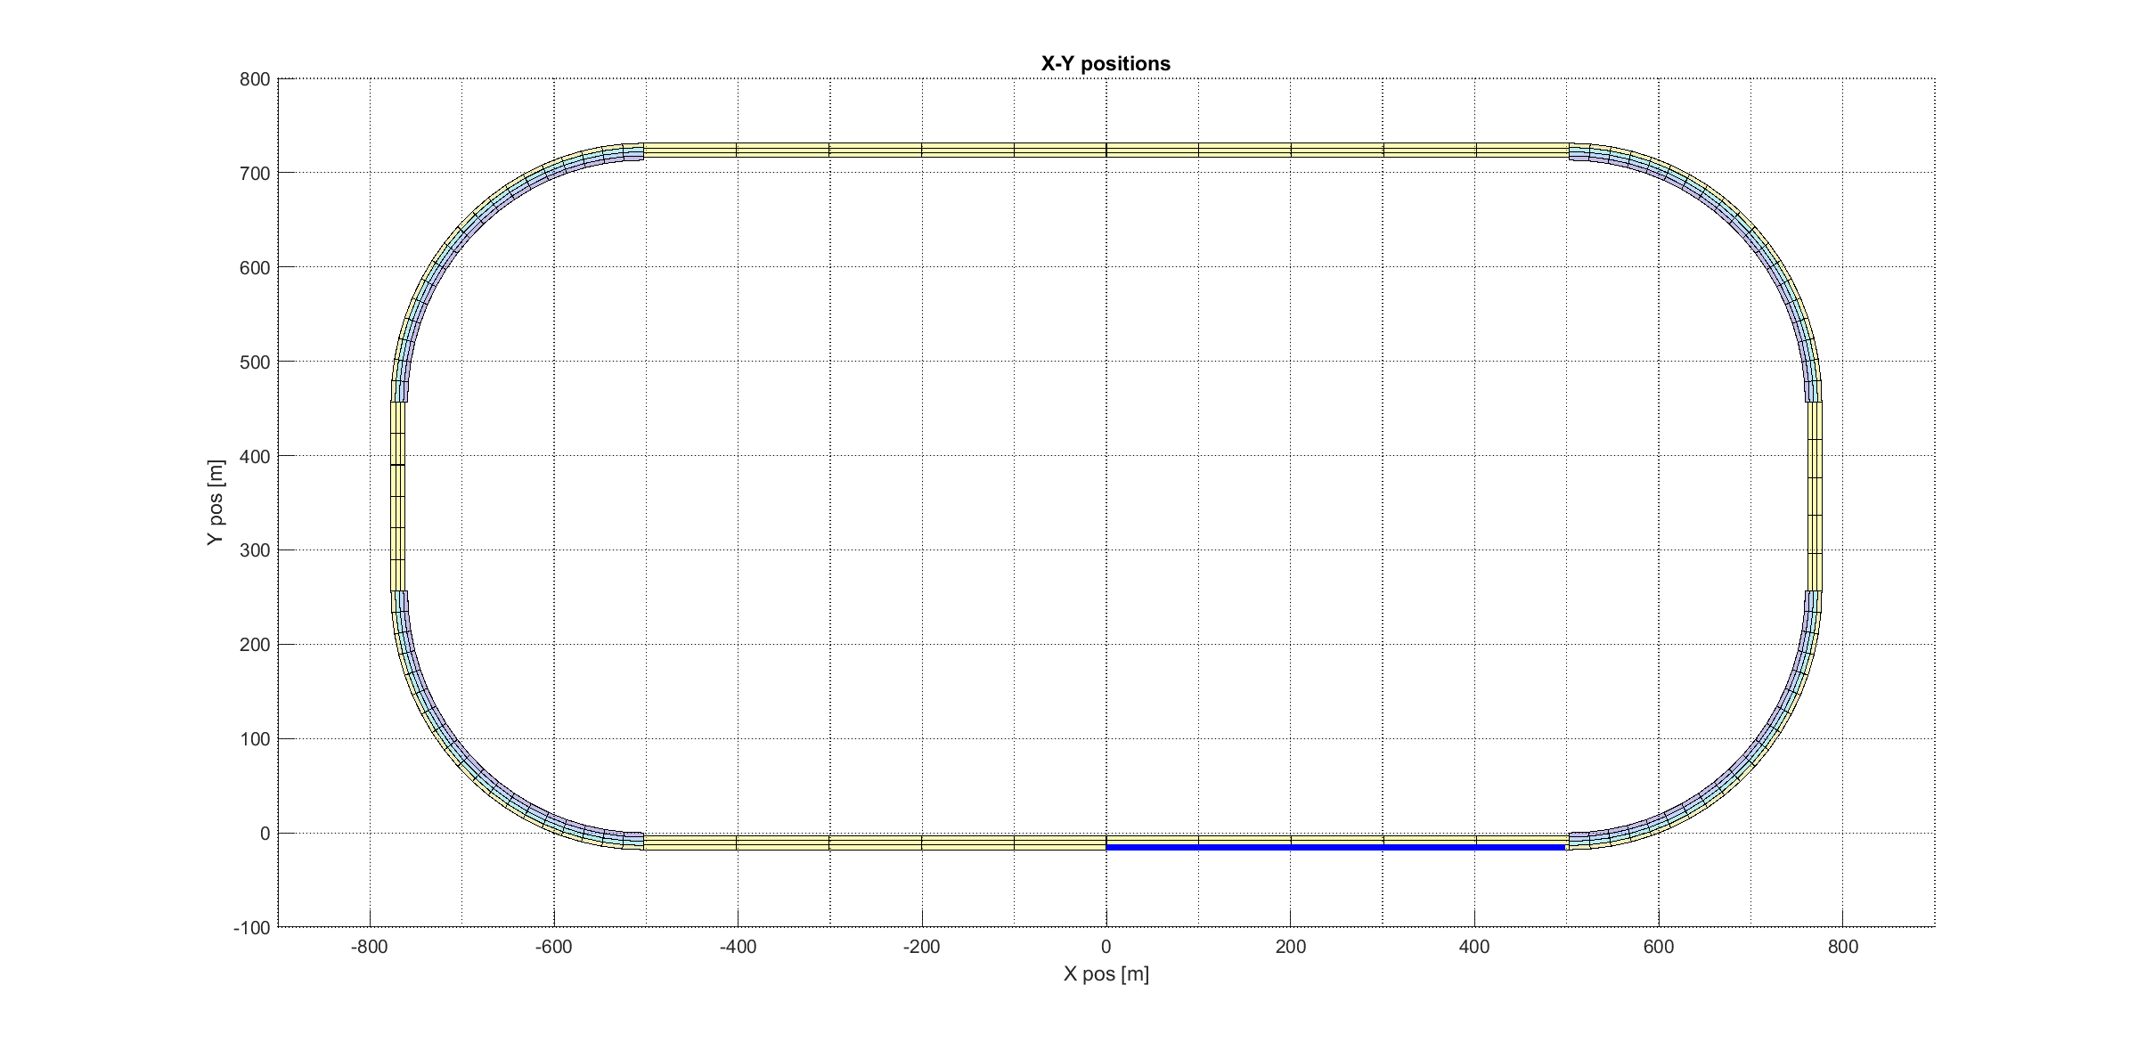
Non-accelerating straight path
Simulation 1

Slide 3
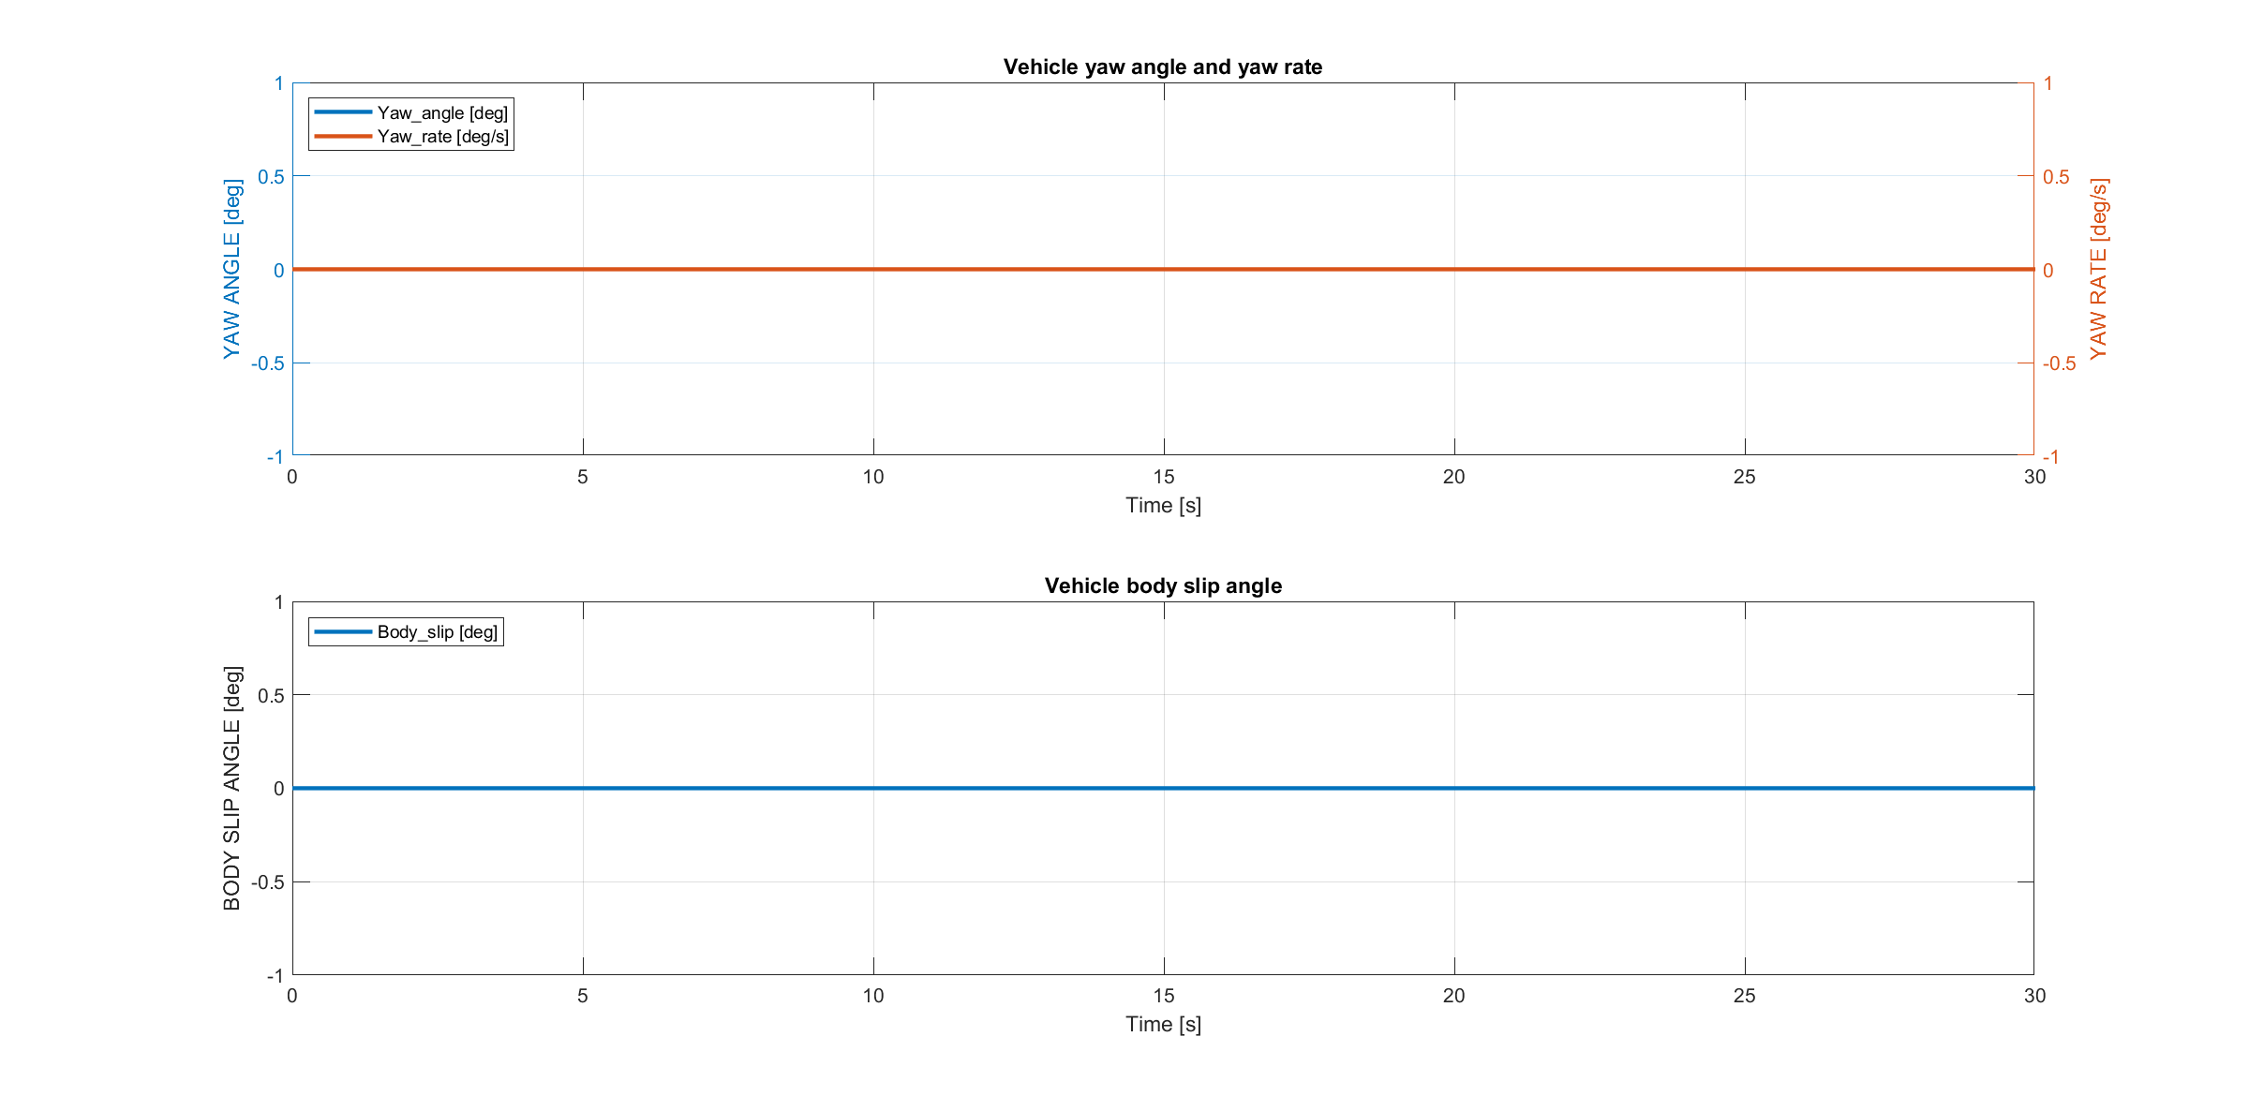
Non-accelerating straight path
Simulation 1

Slide 4
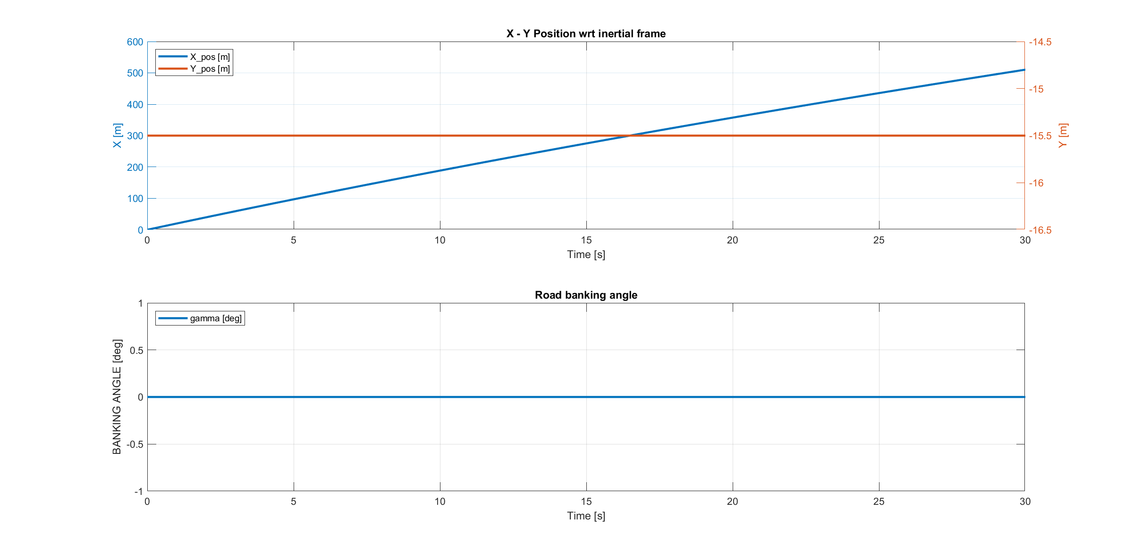
Non-accelerating straight path
Simulation 1

Slide 5
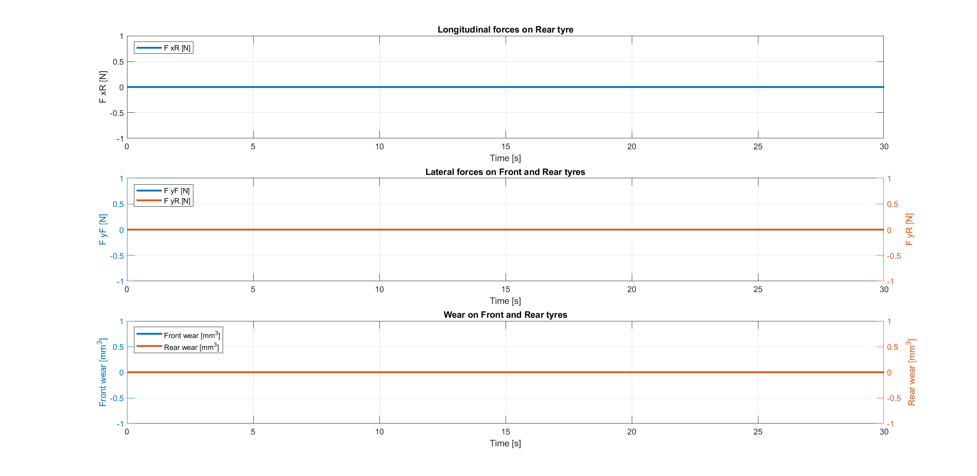
Non-accelerating straight path
Simulation 1

Slide 6
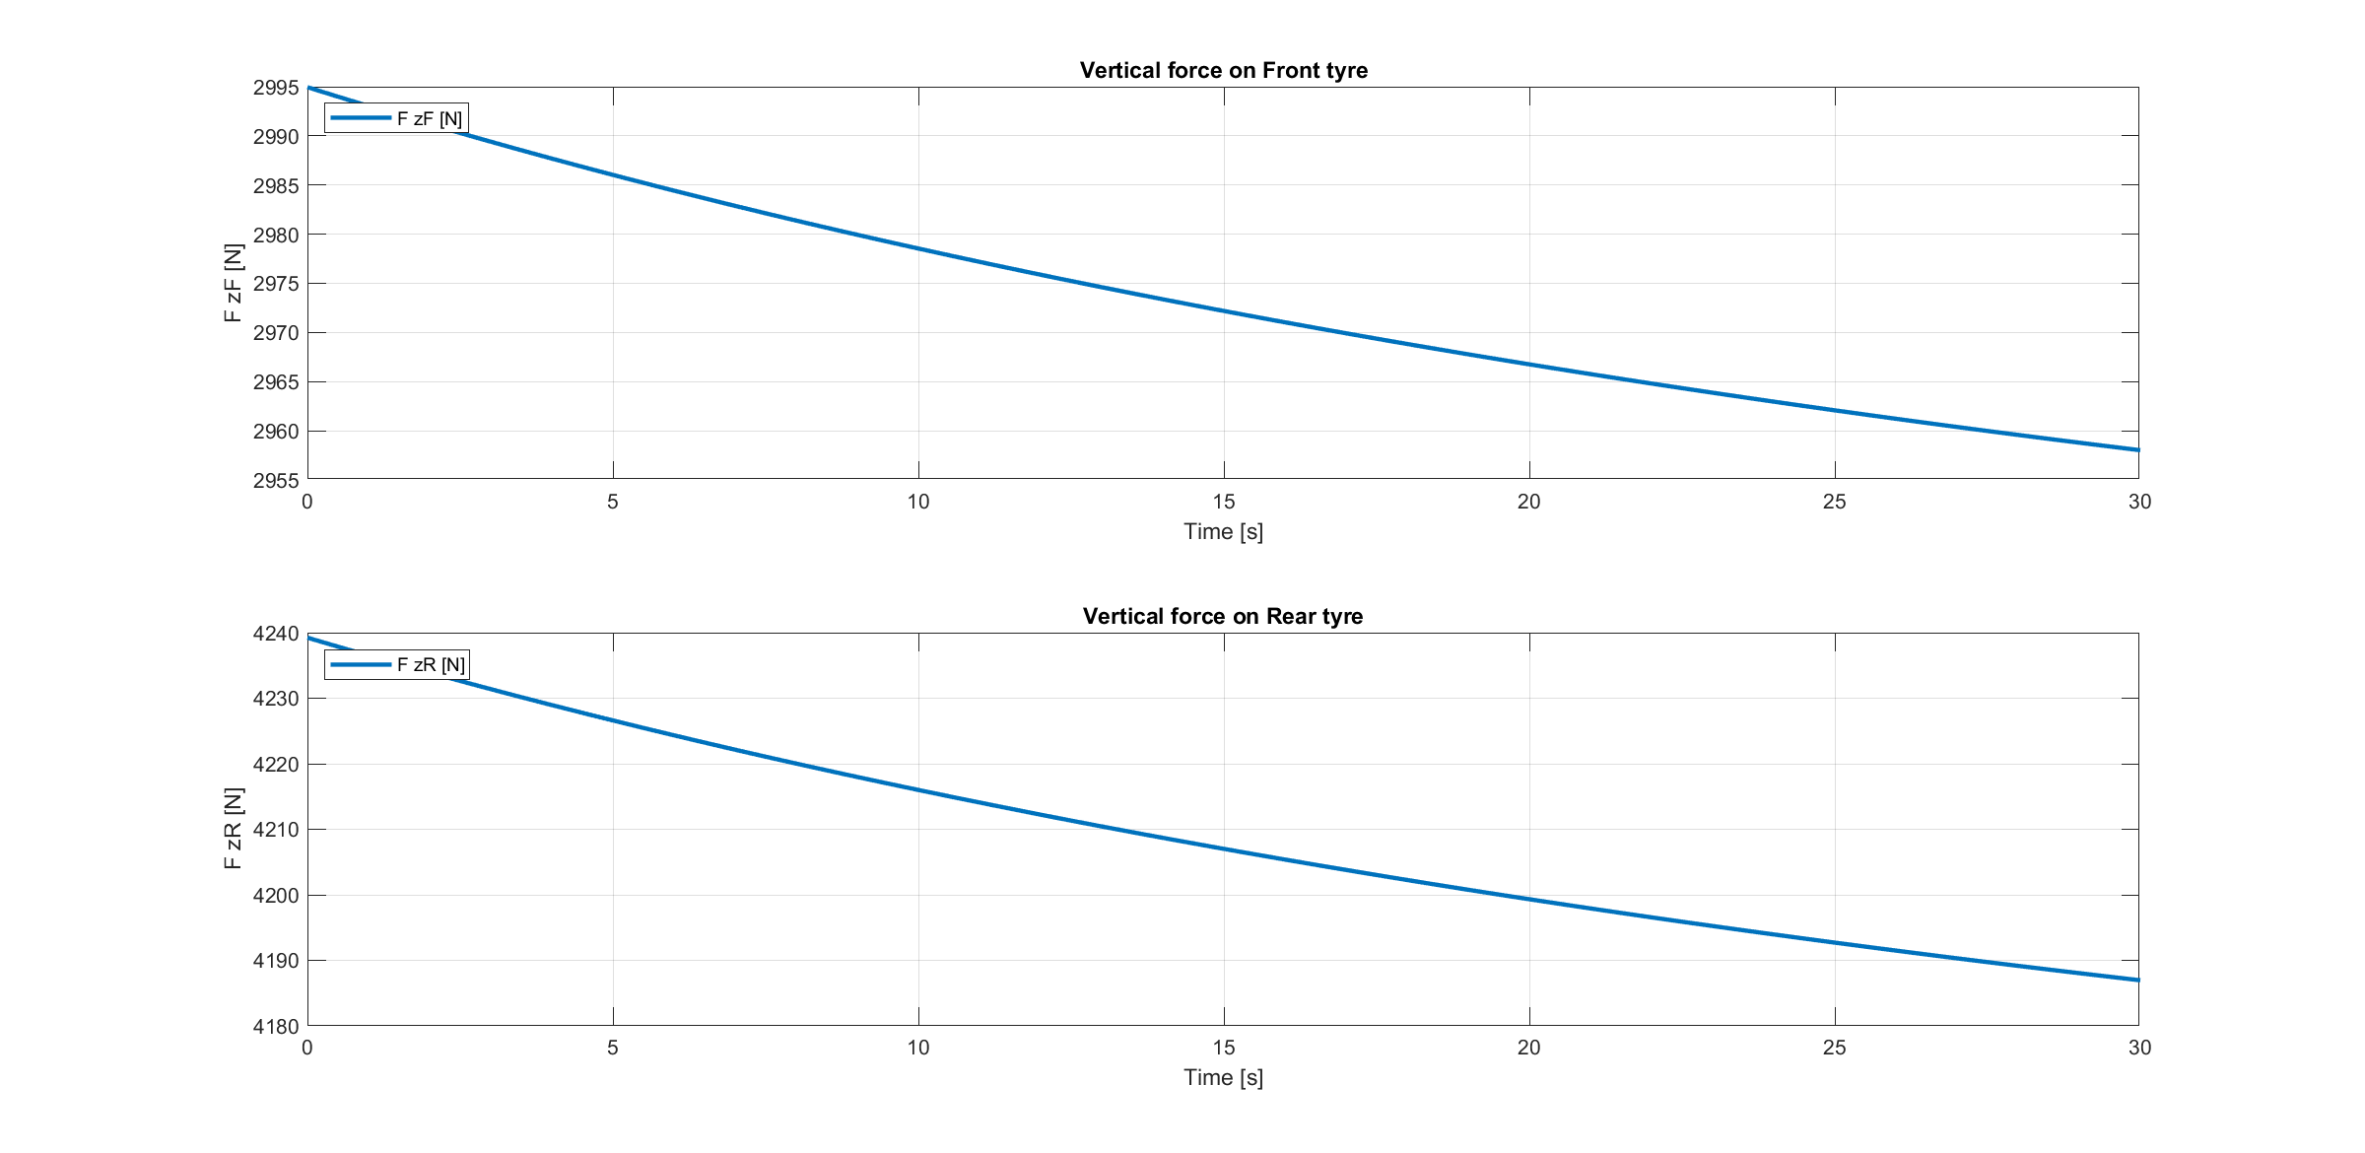
Non-accelerating straight path
Simulation 1

Slide 7
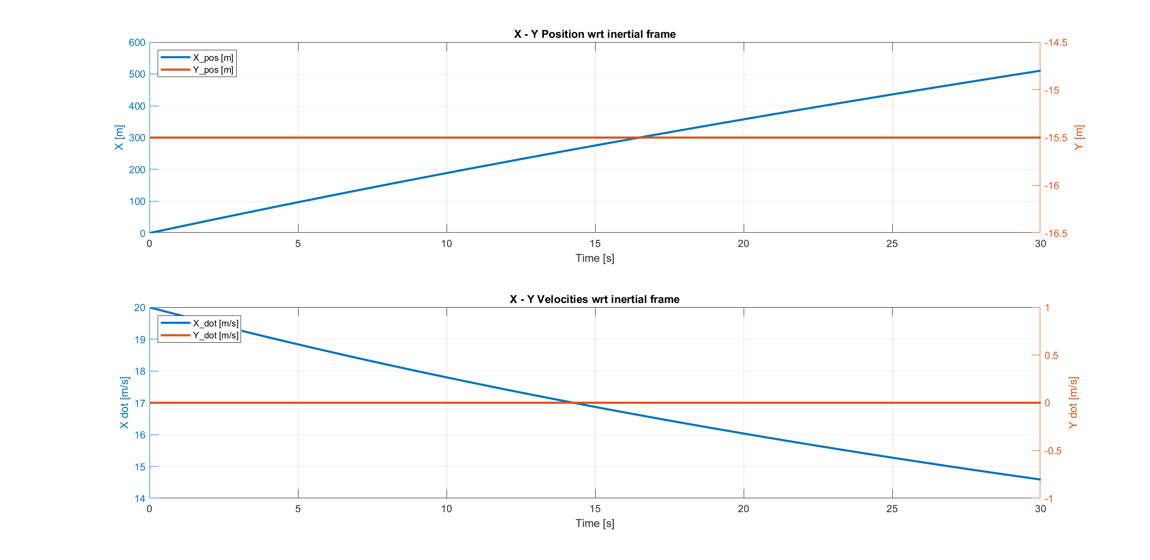
Non-accelerating straight path
Simulation 1

Slide 8
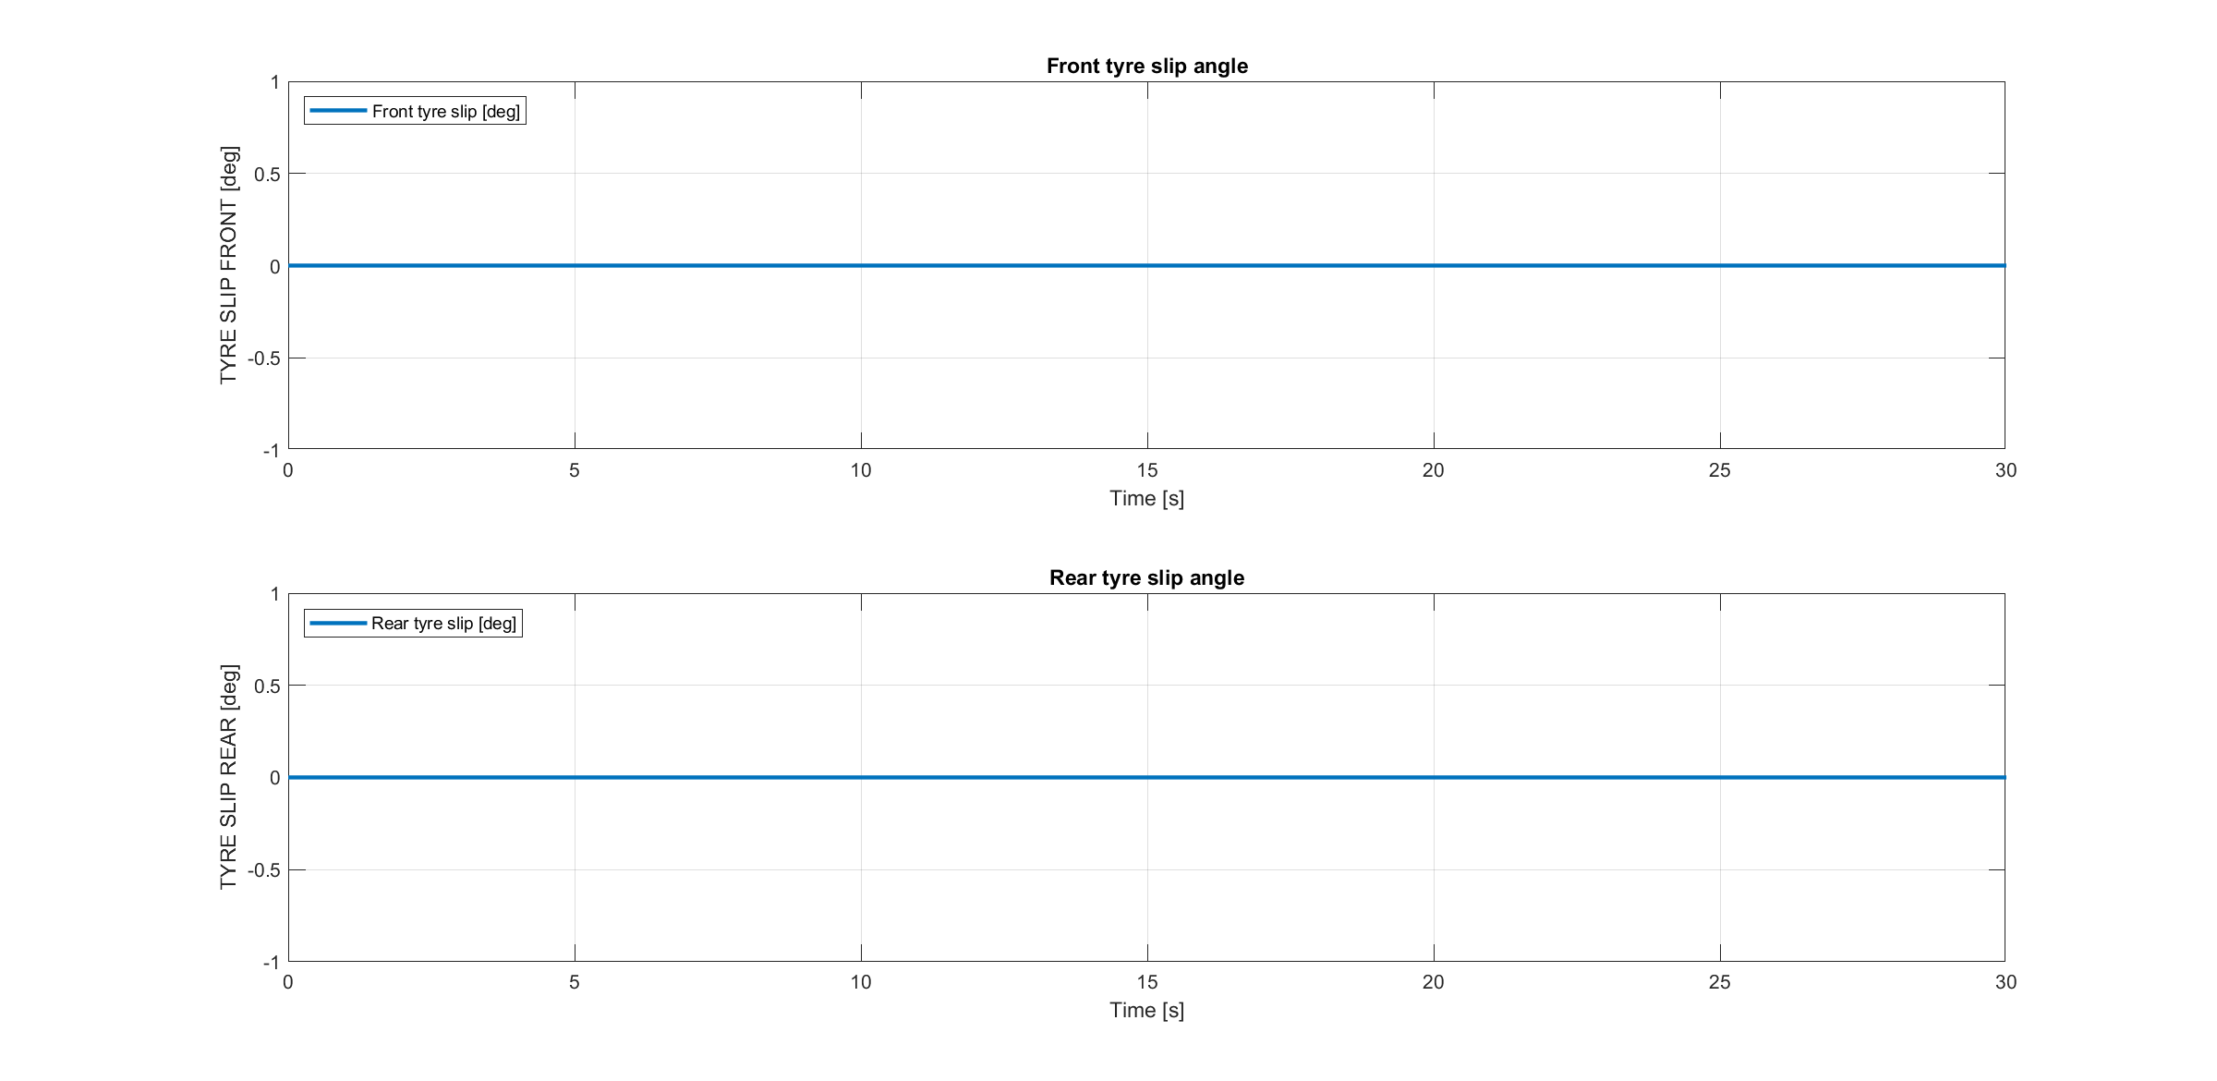
Non-accelerating straight path
Simulation 1

Slide 9
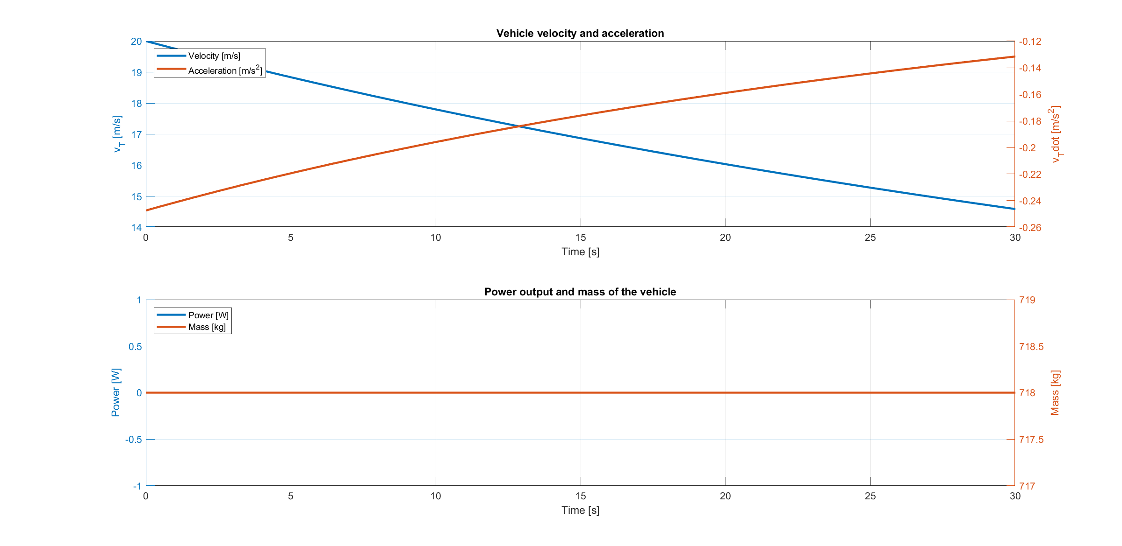
Non-accelerating straight path
Simulation 1

Slide 10

Accelerating straight path
Simulation 2

Slide 11
Accelerating straight path
Simulation 2

Slide 12
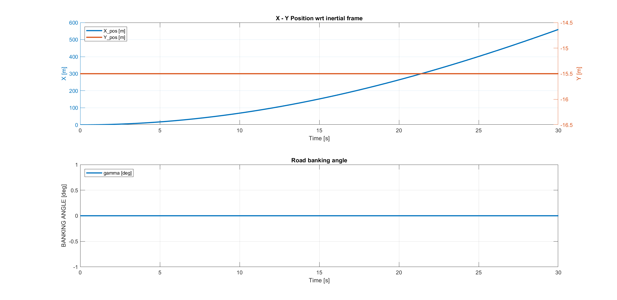
Accelerating straight path
Simulation 2

Slide 13
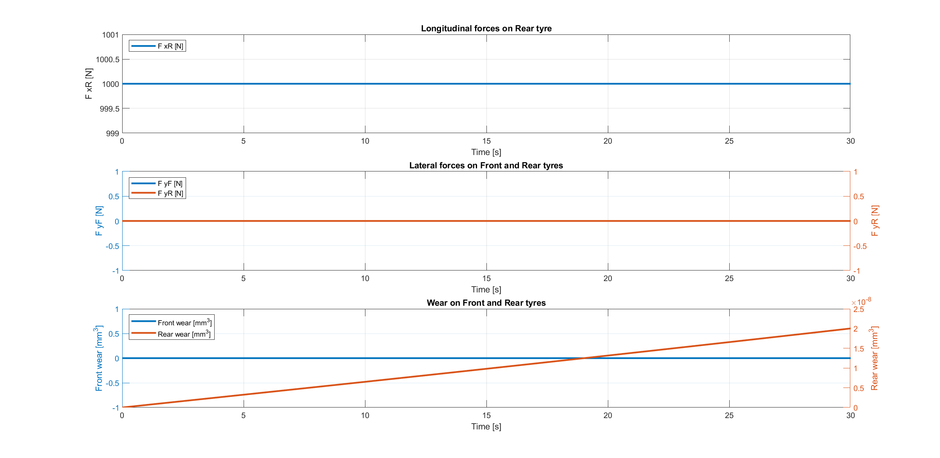
Accelerating straight path
Simulation 2

Slide 14
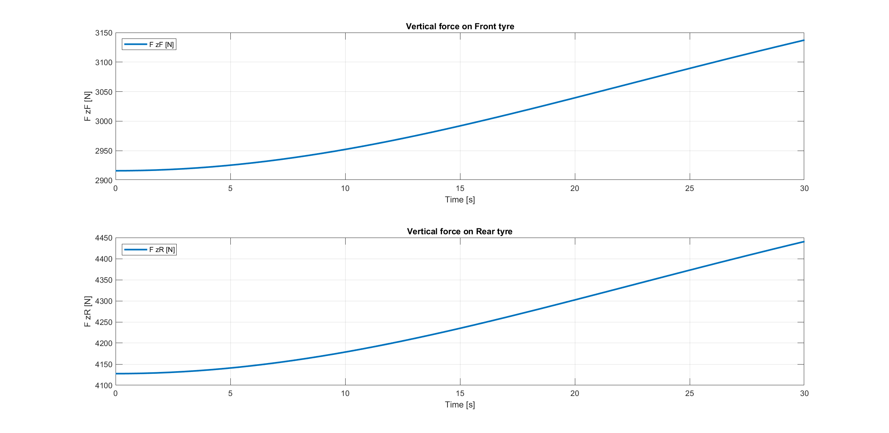
Accelerating straight path
Simulation 2

Slide 15
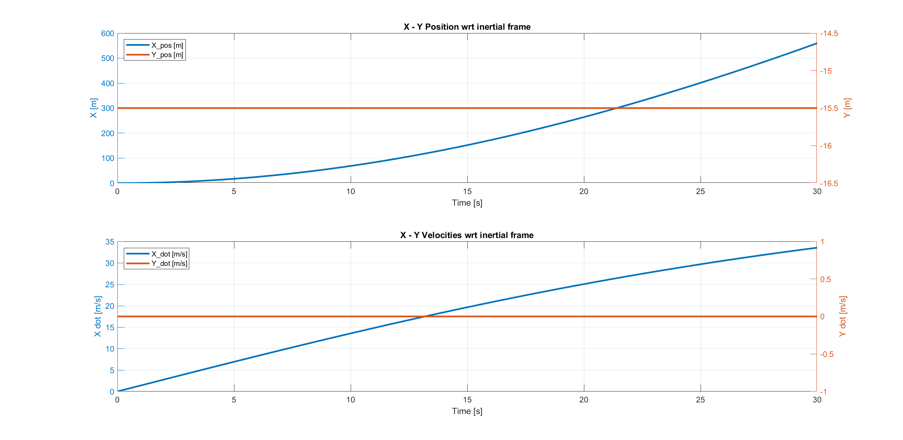
Accelerating straight path
Simulation 2

Slide 16
Accelerating straight path
Simulation 2

Slide 17
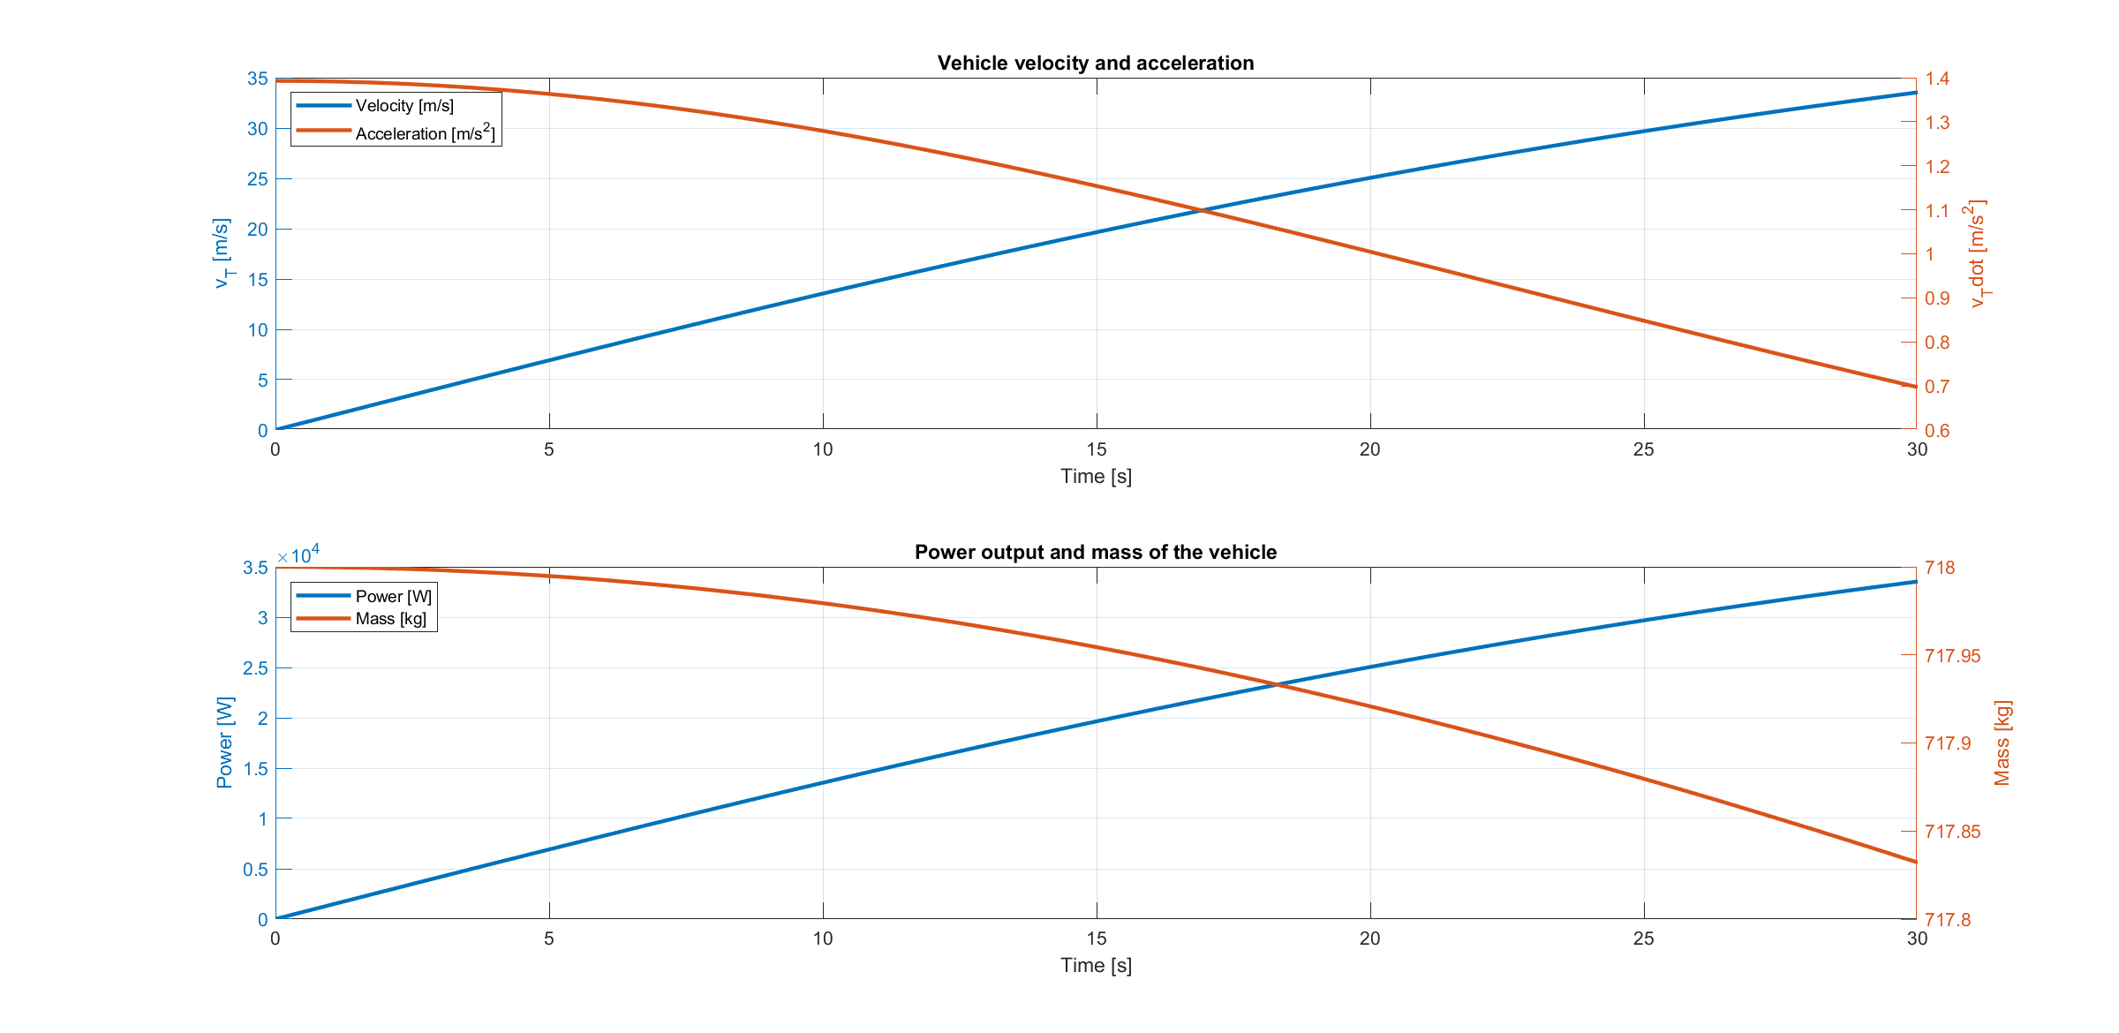
Accelerating straight path
Simulation 2

Slide 18
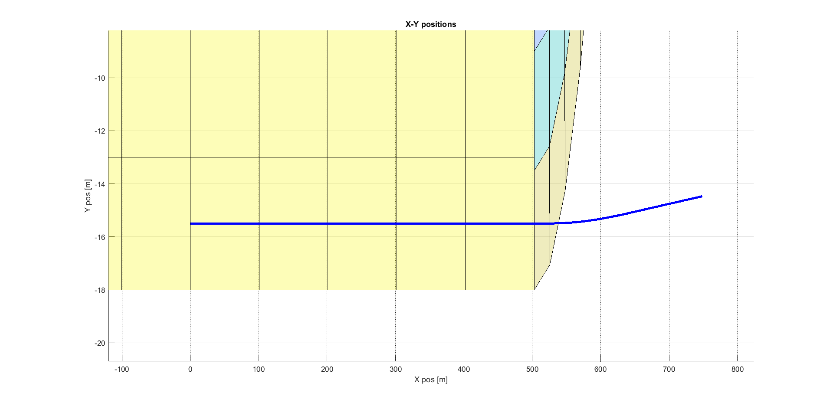
Accelerating straight path on a banked road
Simulation 3

Slide 19
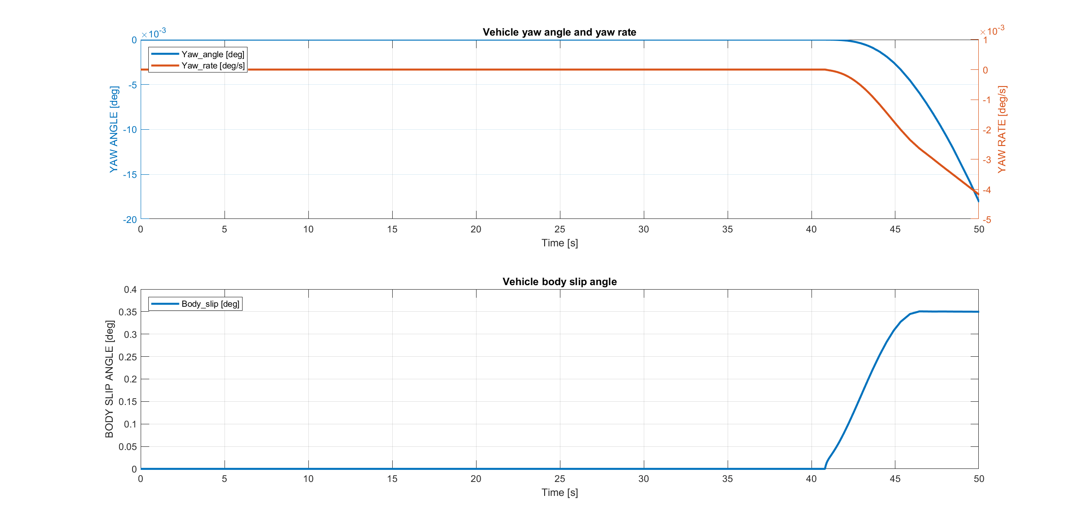
Accelerating straight path on a banked road
Simulation 3

Slide 20
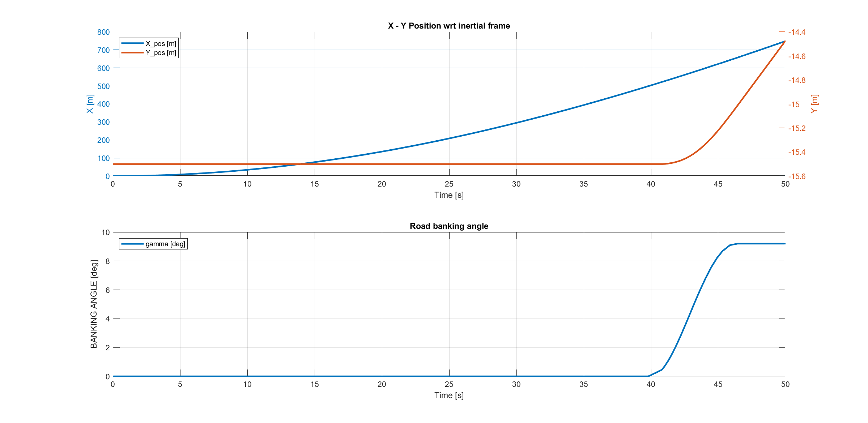
Accelerating straight path on a banked road
Simulation 3

Slide 21
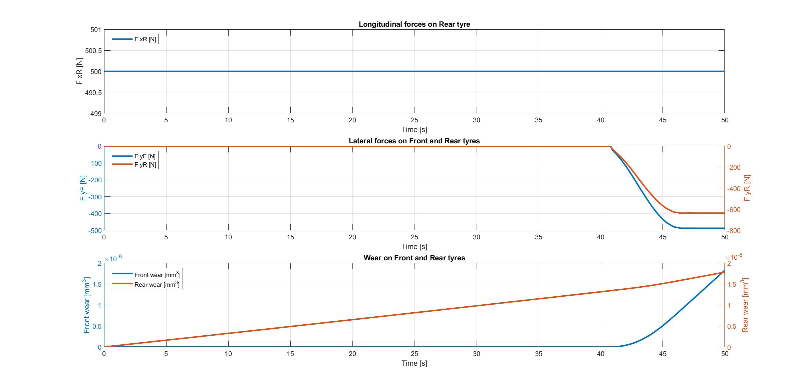
Accelerating straight path on a banked road
Simulation 3

Slide 22
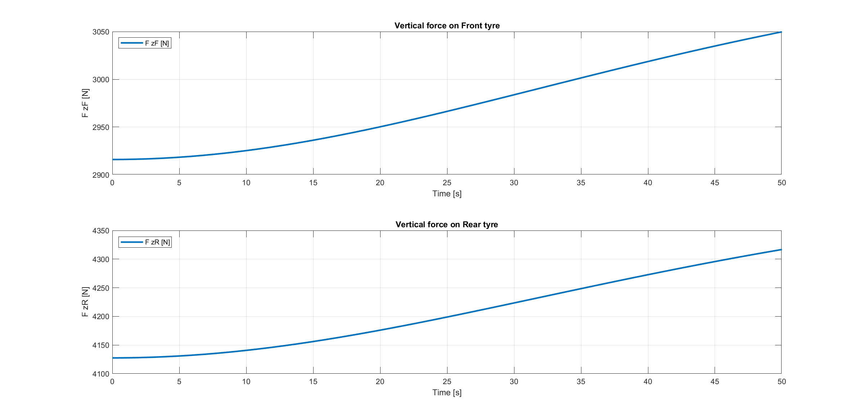
Accelerating straight path on a banked road
Simulation 3

Slide 23
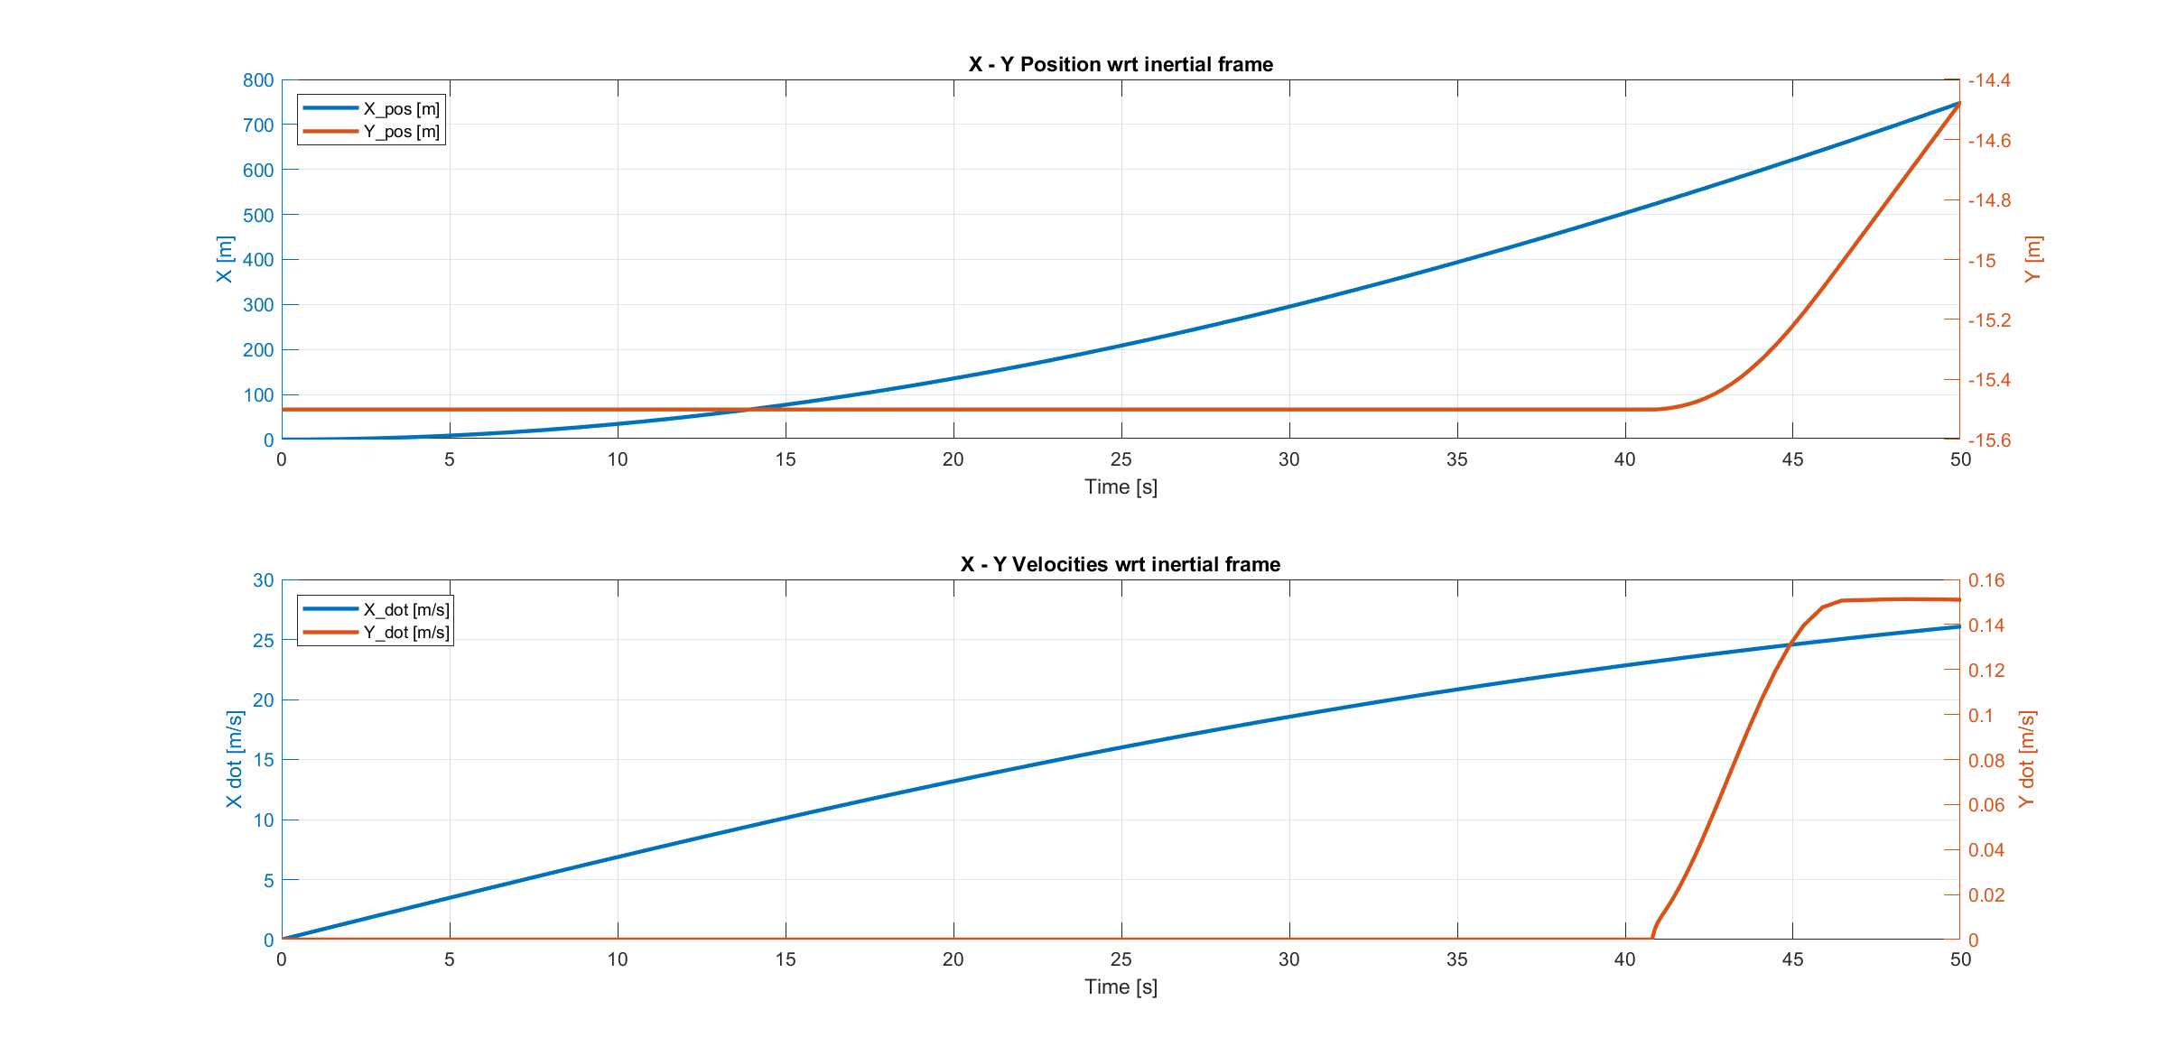
Accelerating straight path on a banked road
Simulation 3

Slide 24
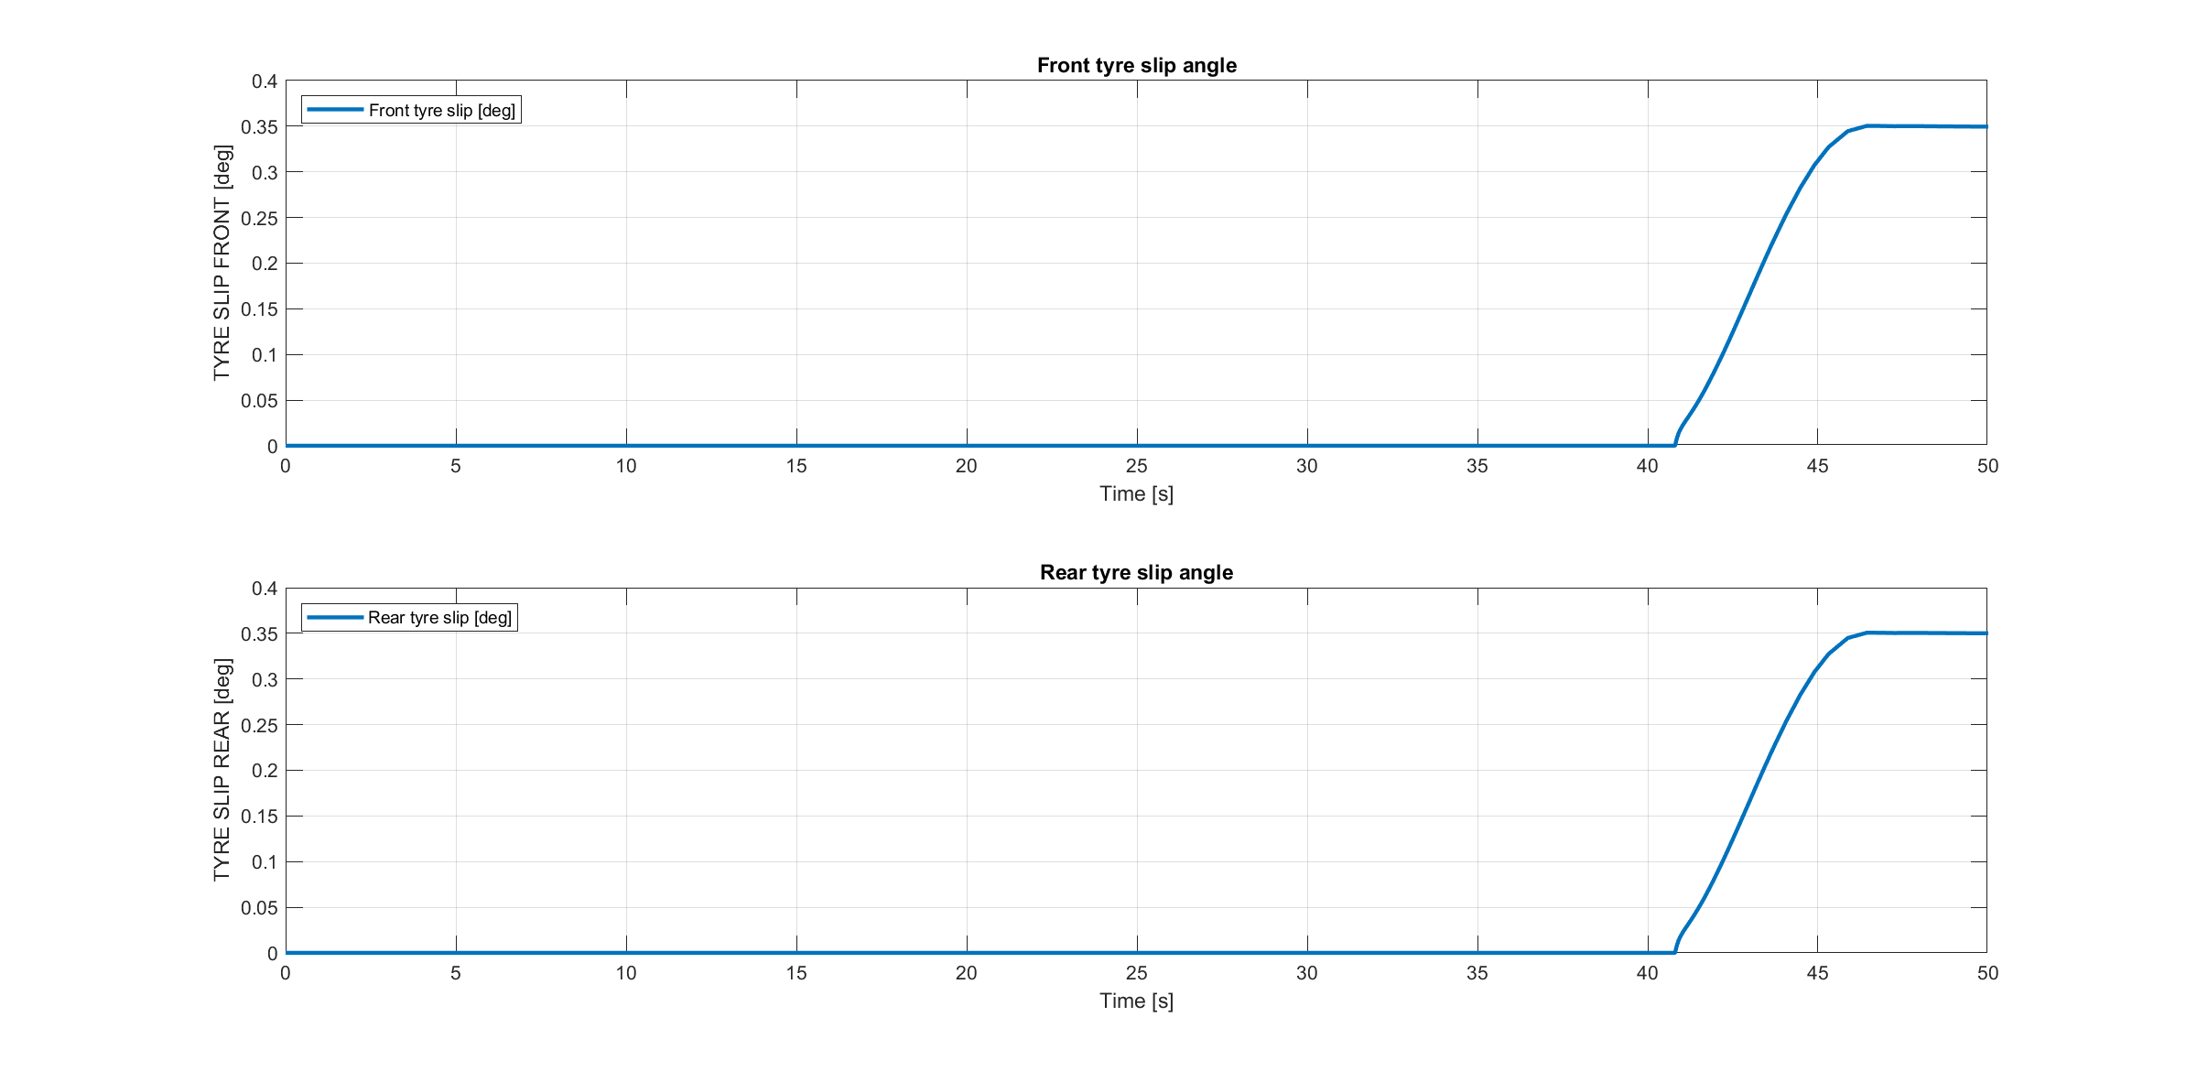
Accelerating straight path on a banked road
Simulation 3

Slide 25
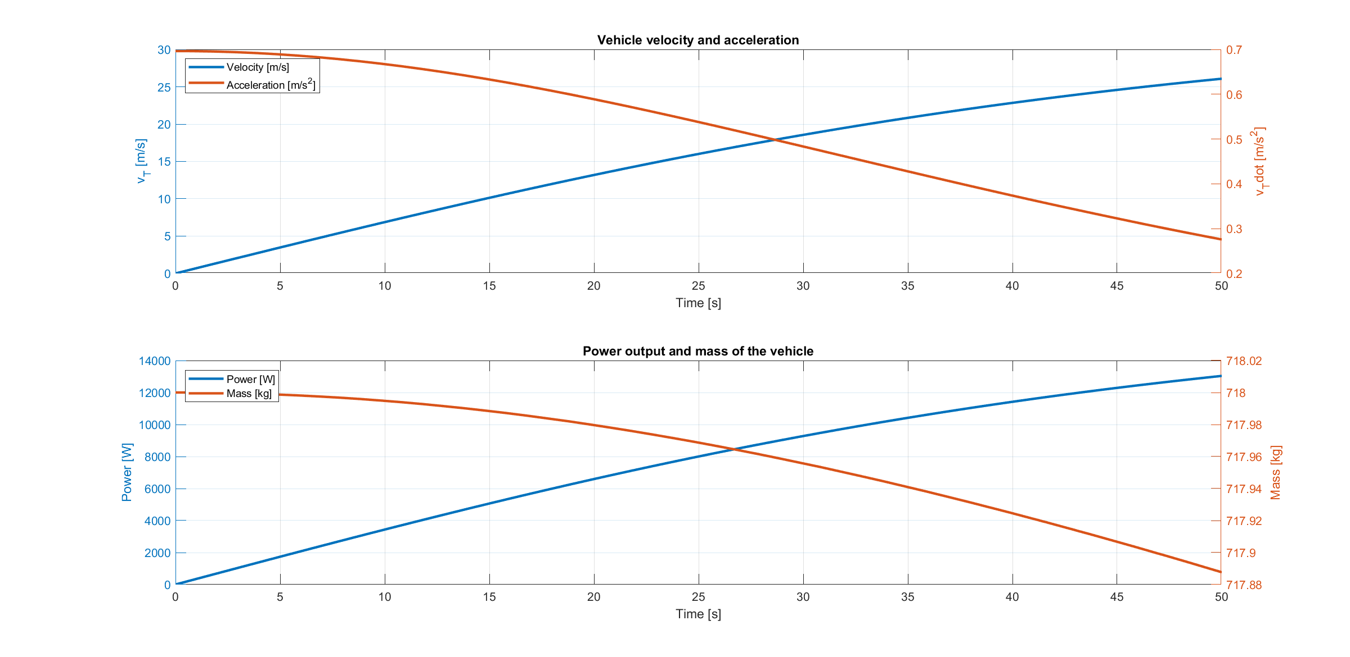
Accelerating straight path on a banked road
Simulation 3

Slide 26
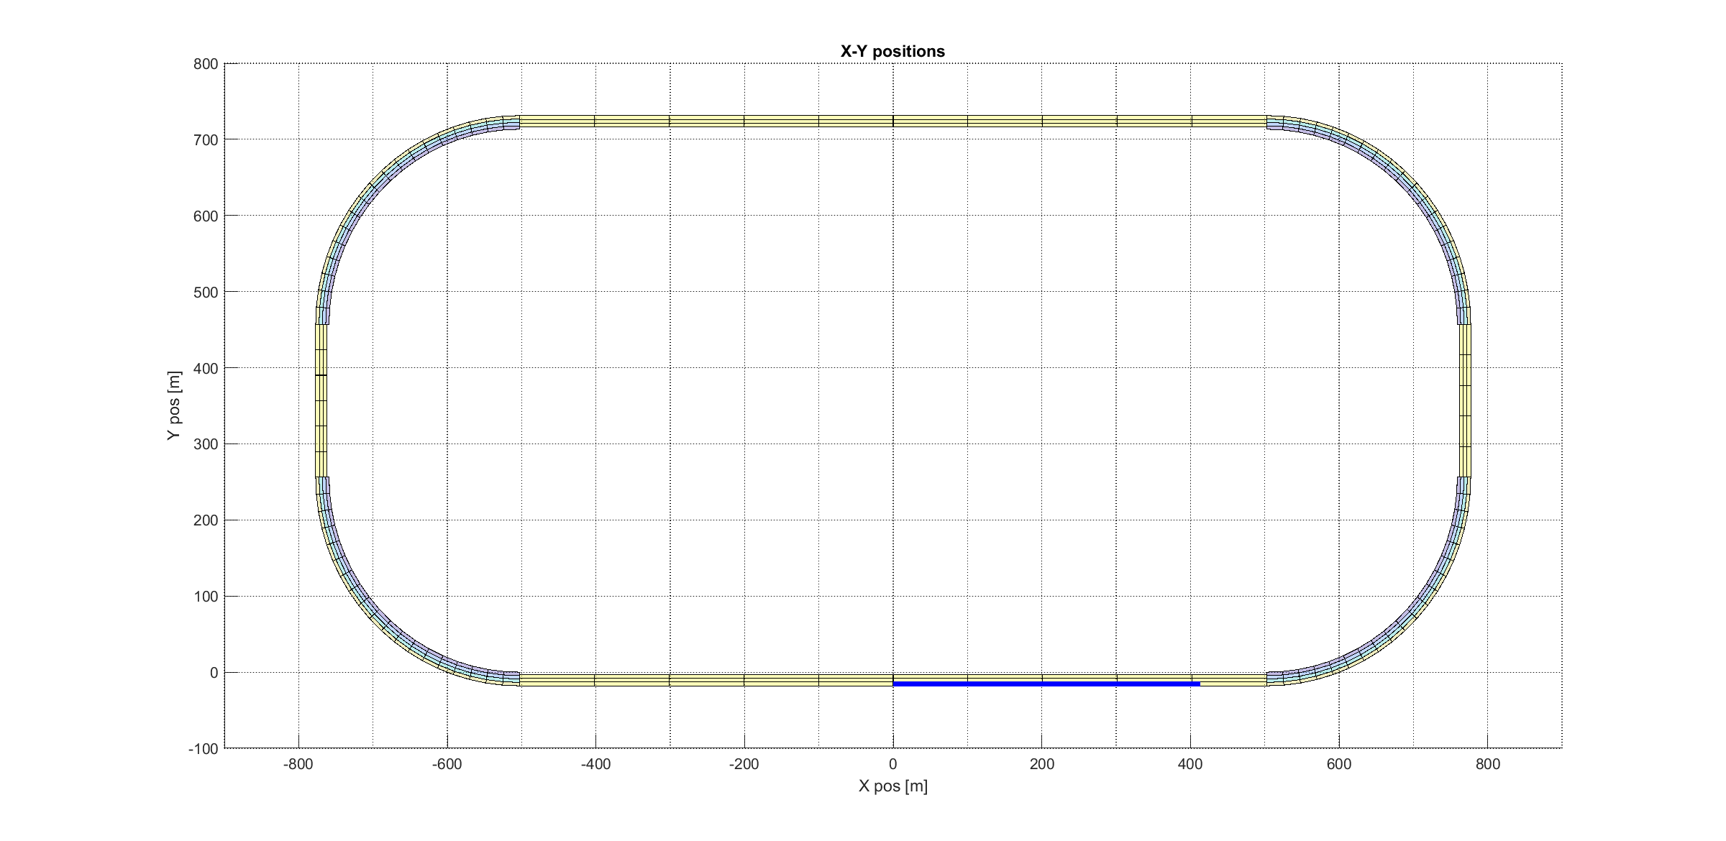
Accelerating-Breaking straight path
Simulation 4

Slide 27
Accelerating-Breaking straight path
Simulation 4

Slide 28
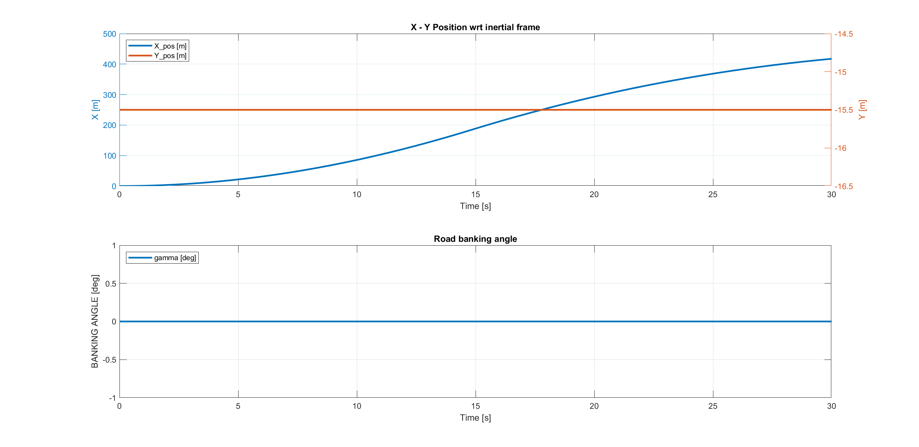
Accelerating-Breaking straight path
Simulation 4

Slide 29
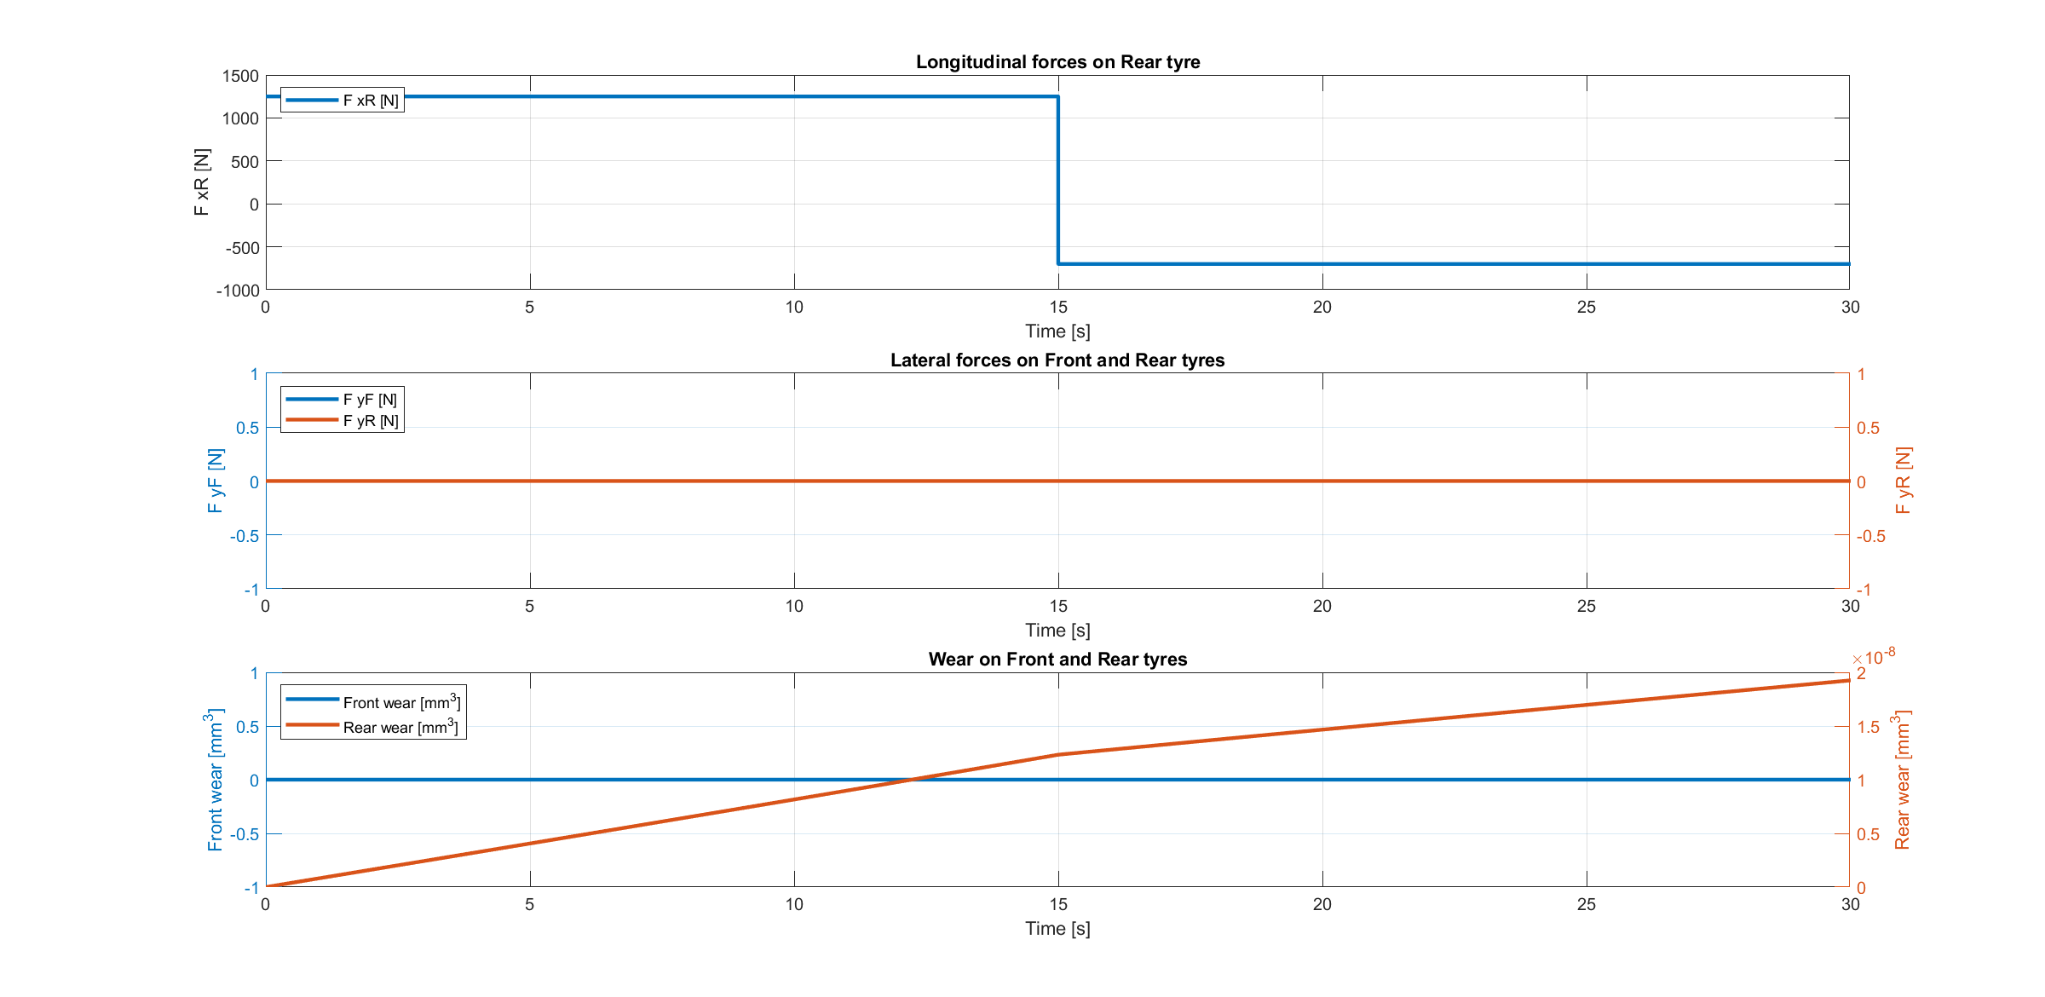
Accelerating-Breaking straight path
Simulation 4

Slide 30
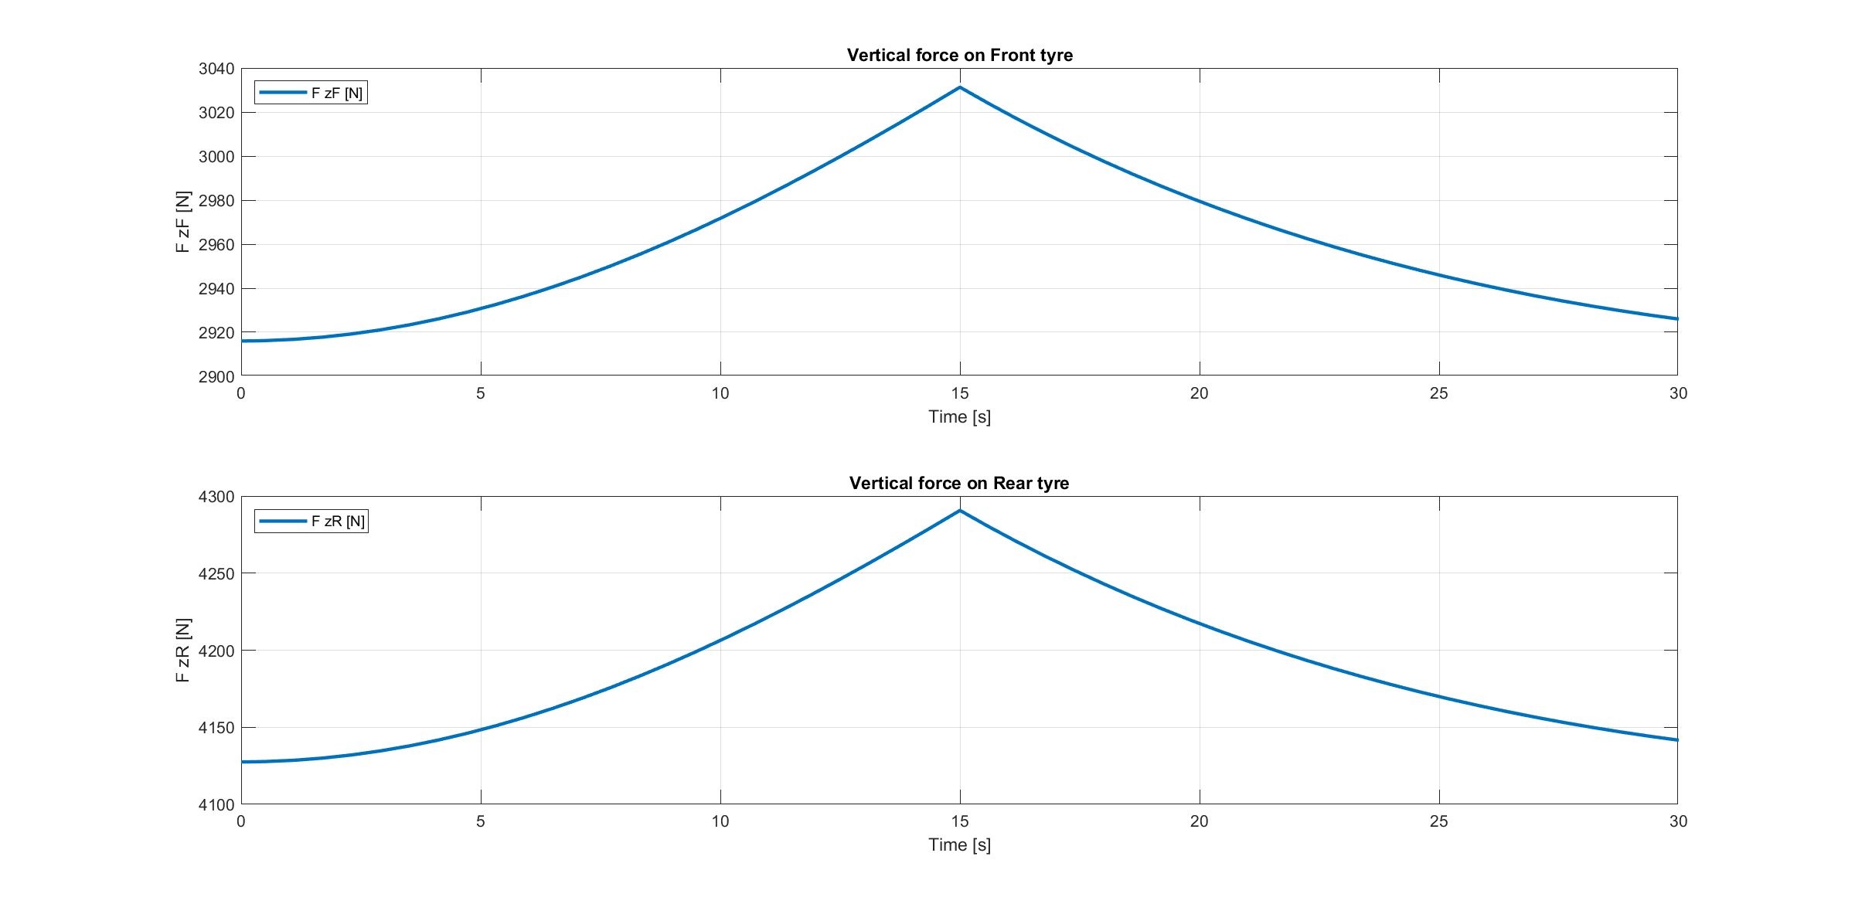
Accelerating-Breaking straight path
Simulation 4

Slide 31
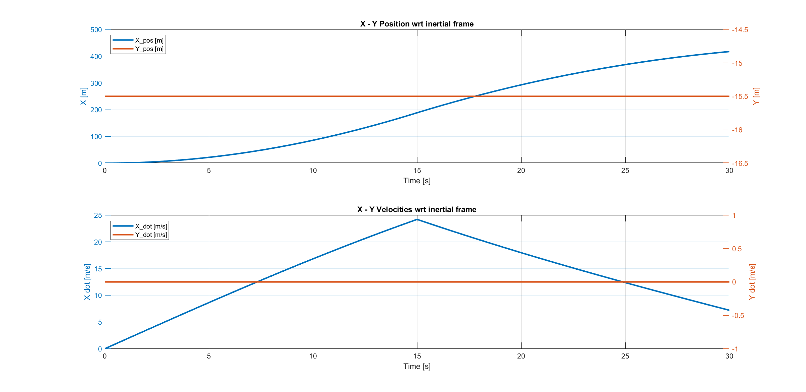
Accelerating-Breaking straight path
Simulation 4

Slide 32
Accelerating-Breaking straight path
Simulation 4

Slide 33
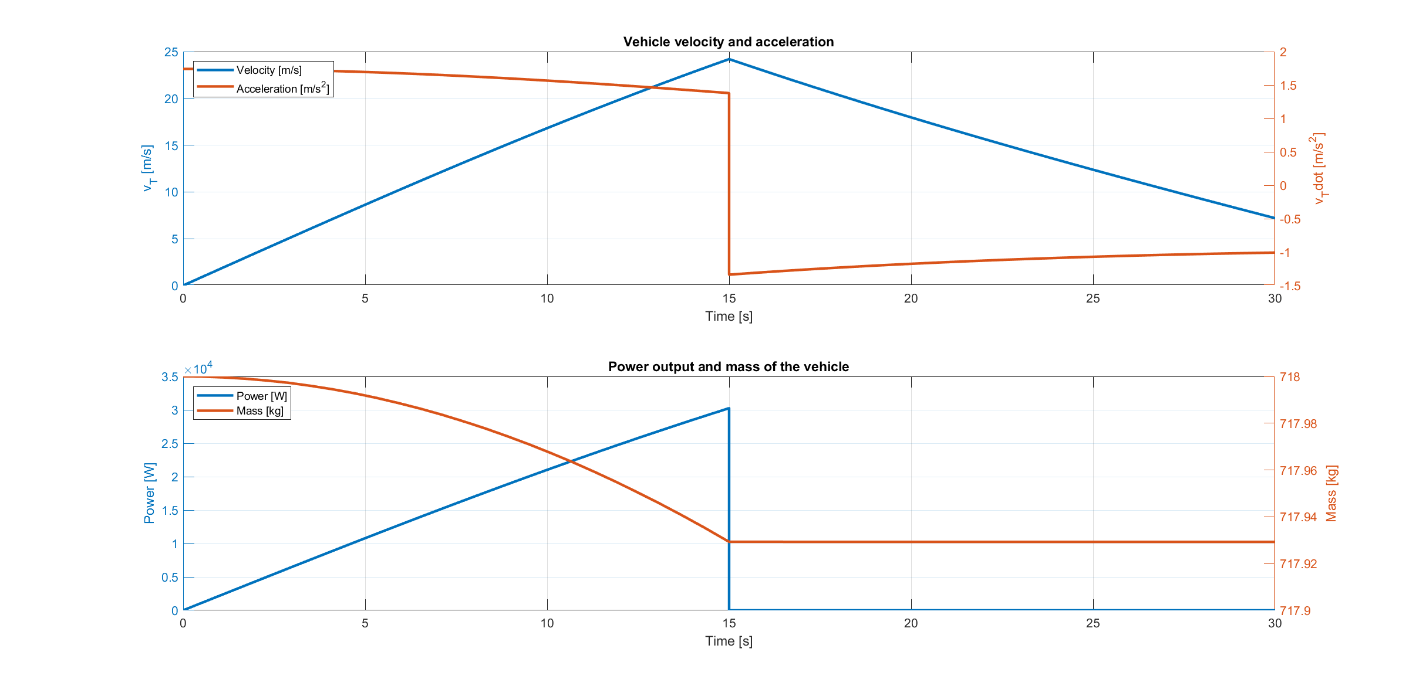
Accelerating-Breaking straight path
Simulation 4

Slide 34
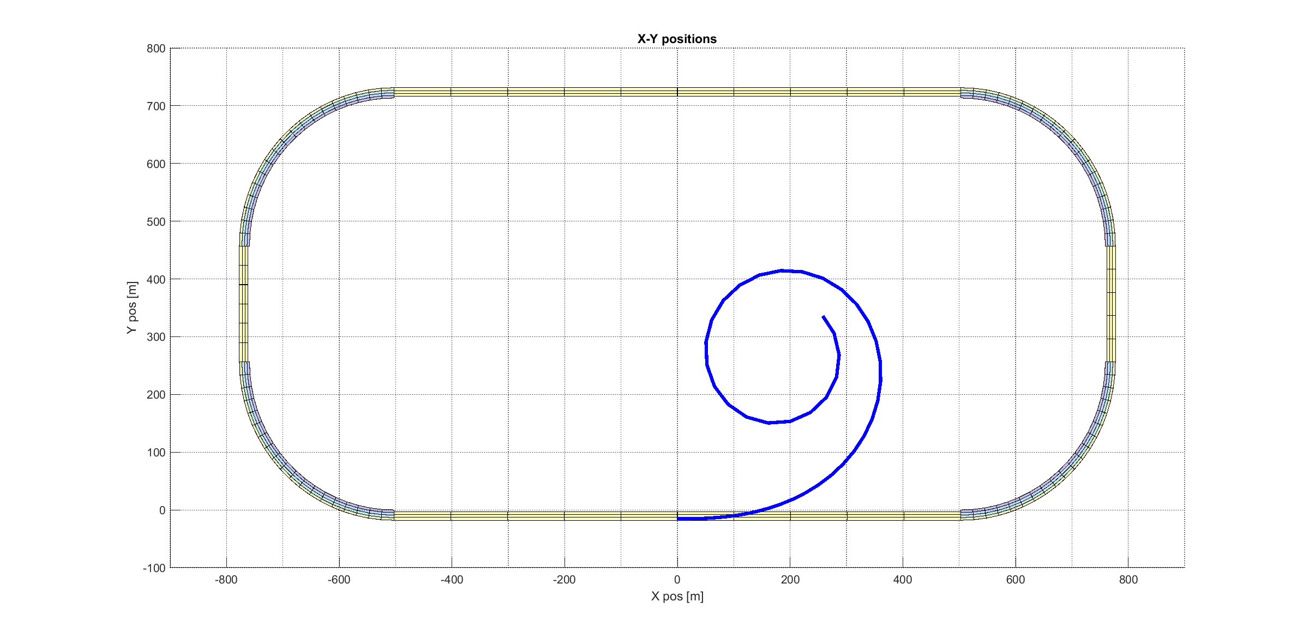
Constant steer and increasing velocity path
Simulation 5

Slide 35
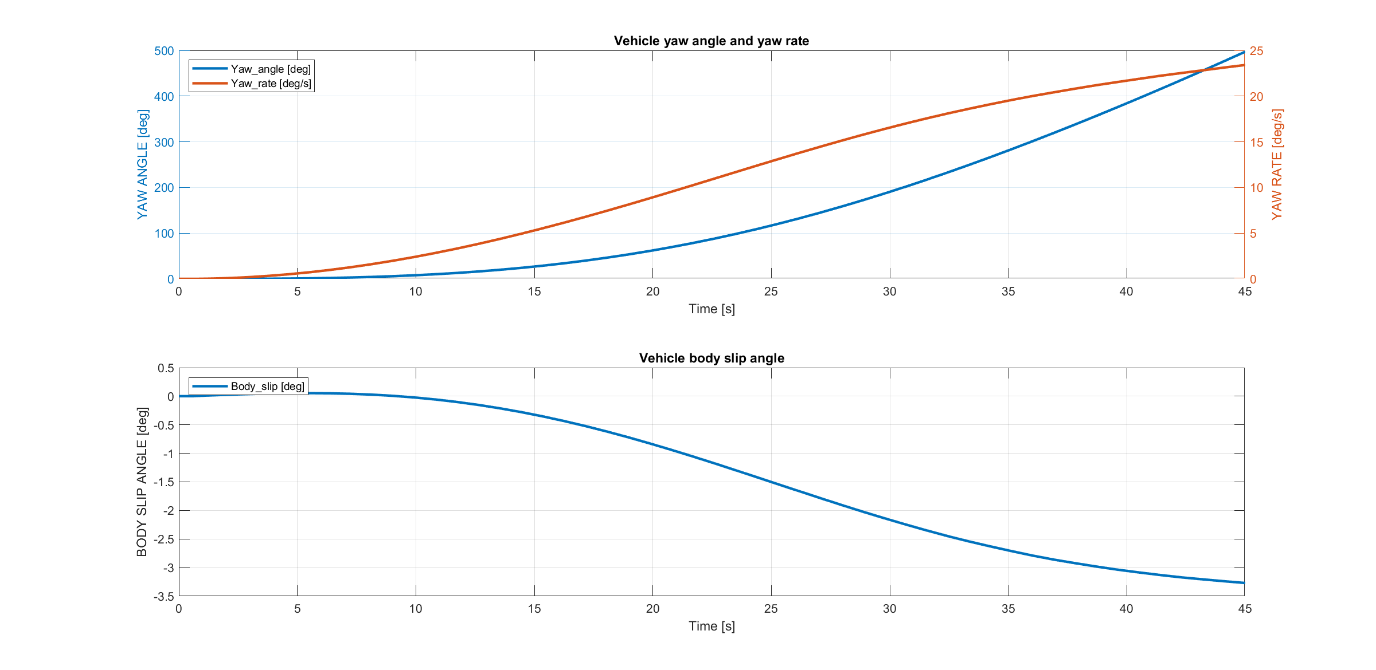
Constant steer and increasing velocity path
Simulation 5

Slide 36
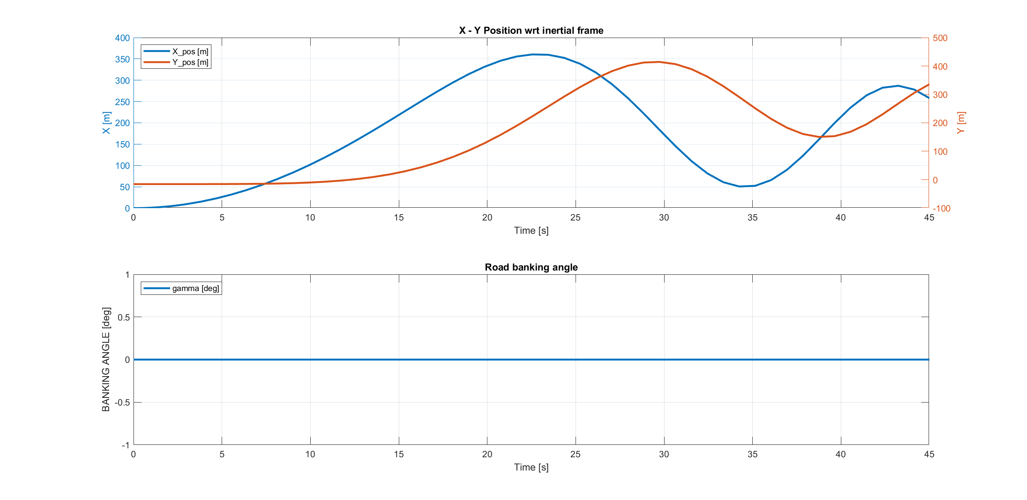
Constant steer and increasing velocity path
Simulation 5

Slide 37
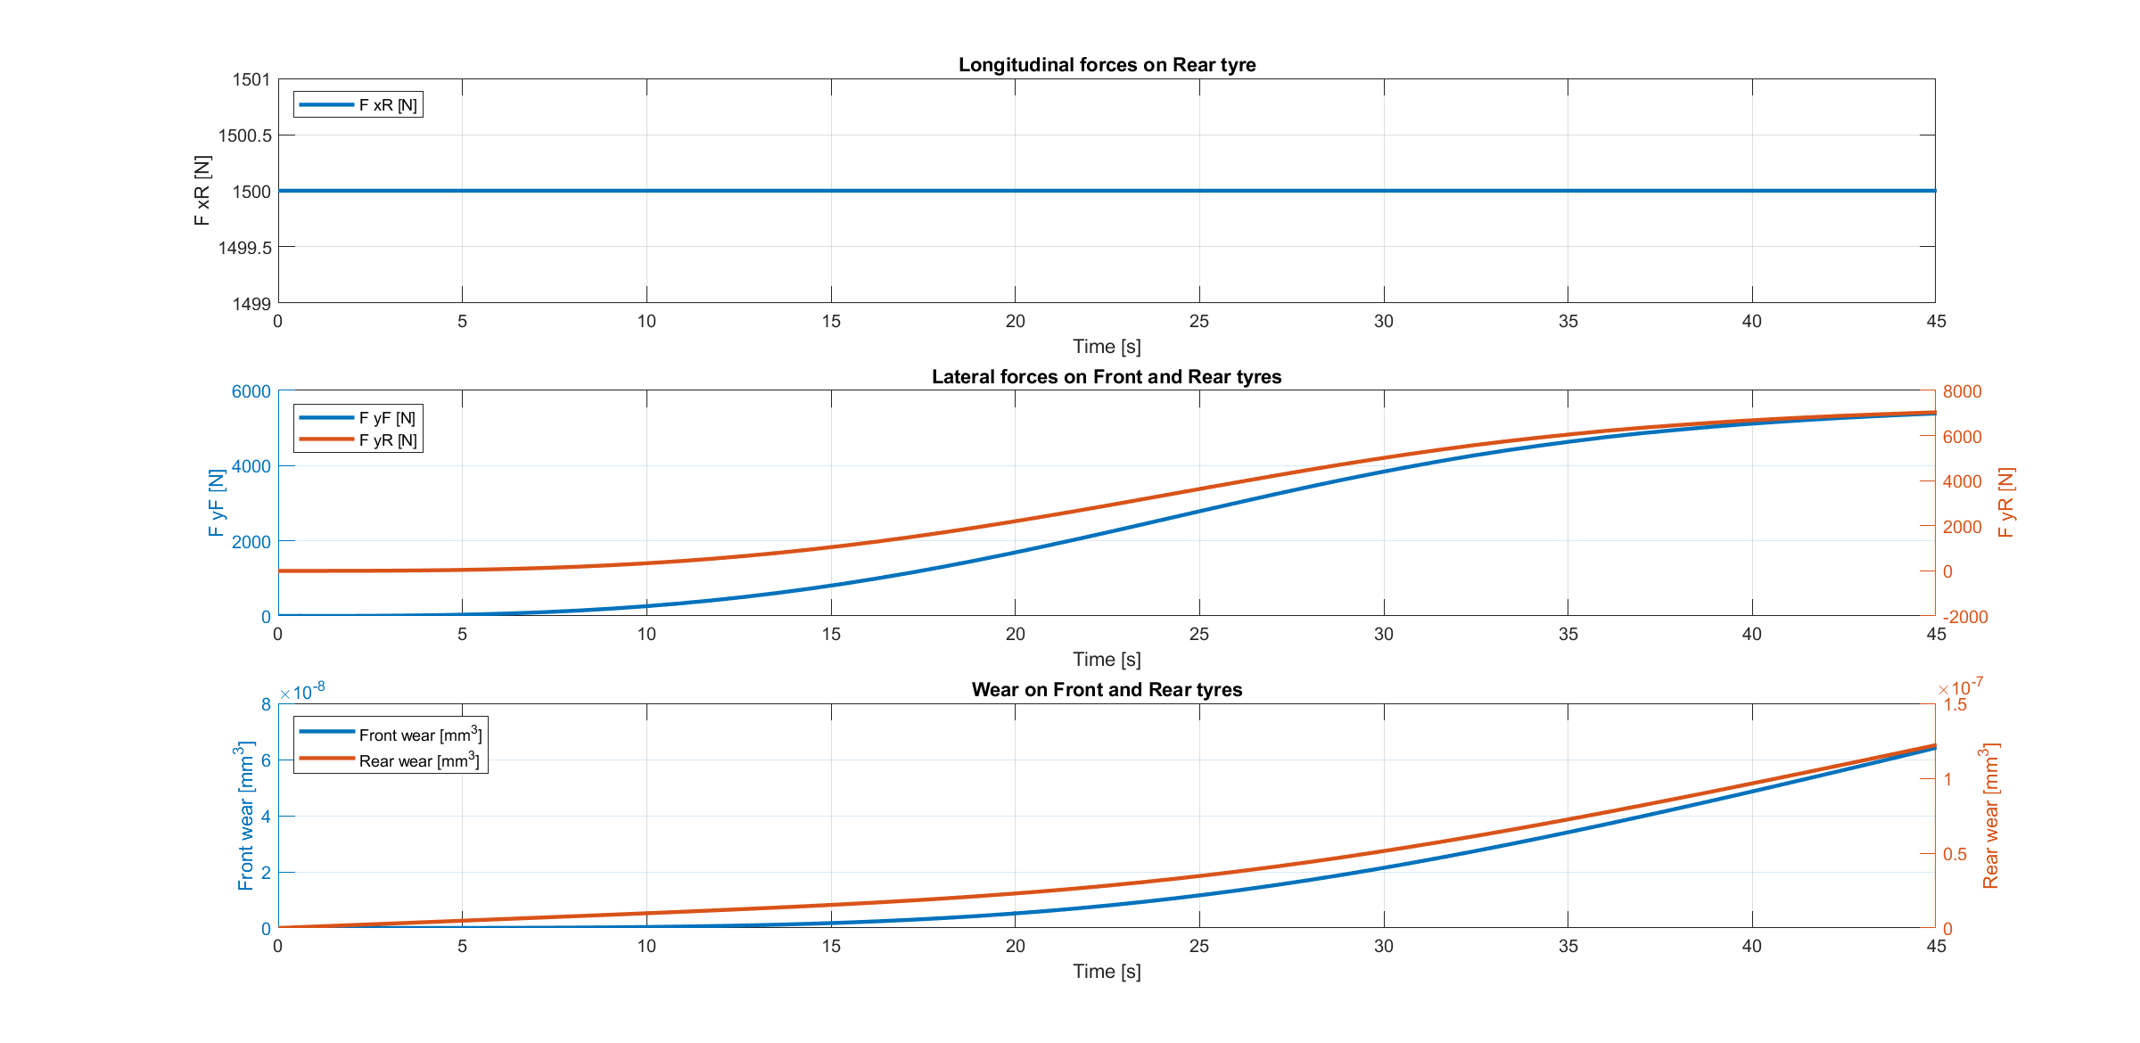
Constant steer and increasing velocity path
Simulation 5

Slide 38
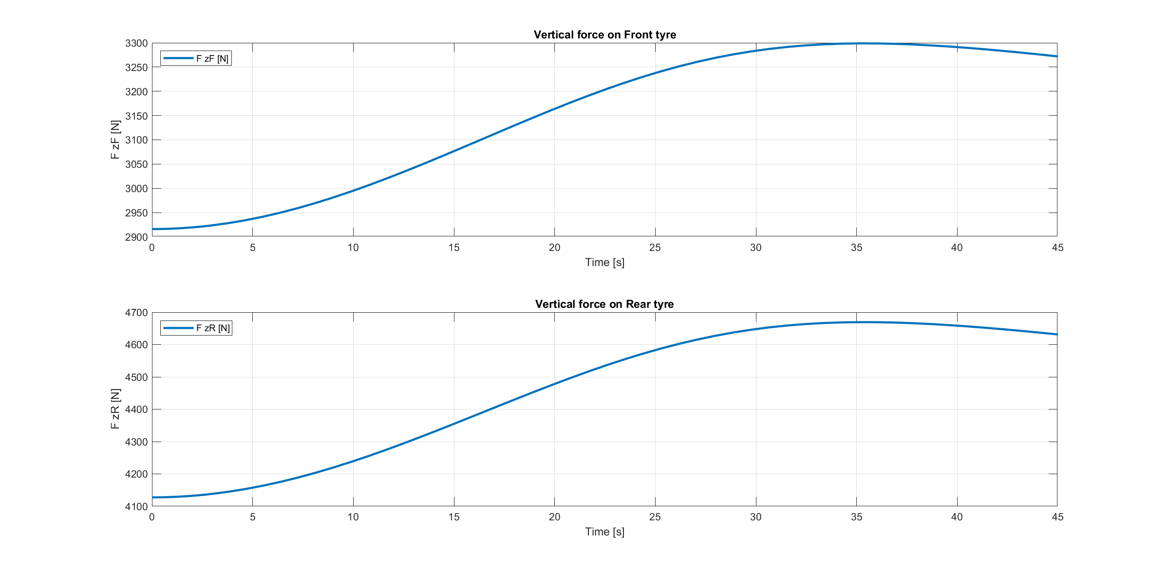
Constant steer and increasing velocity path
Simulation 5

Slide 39
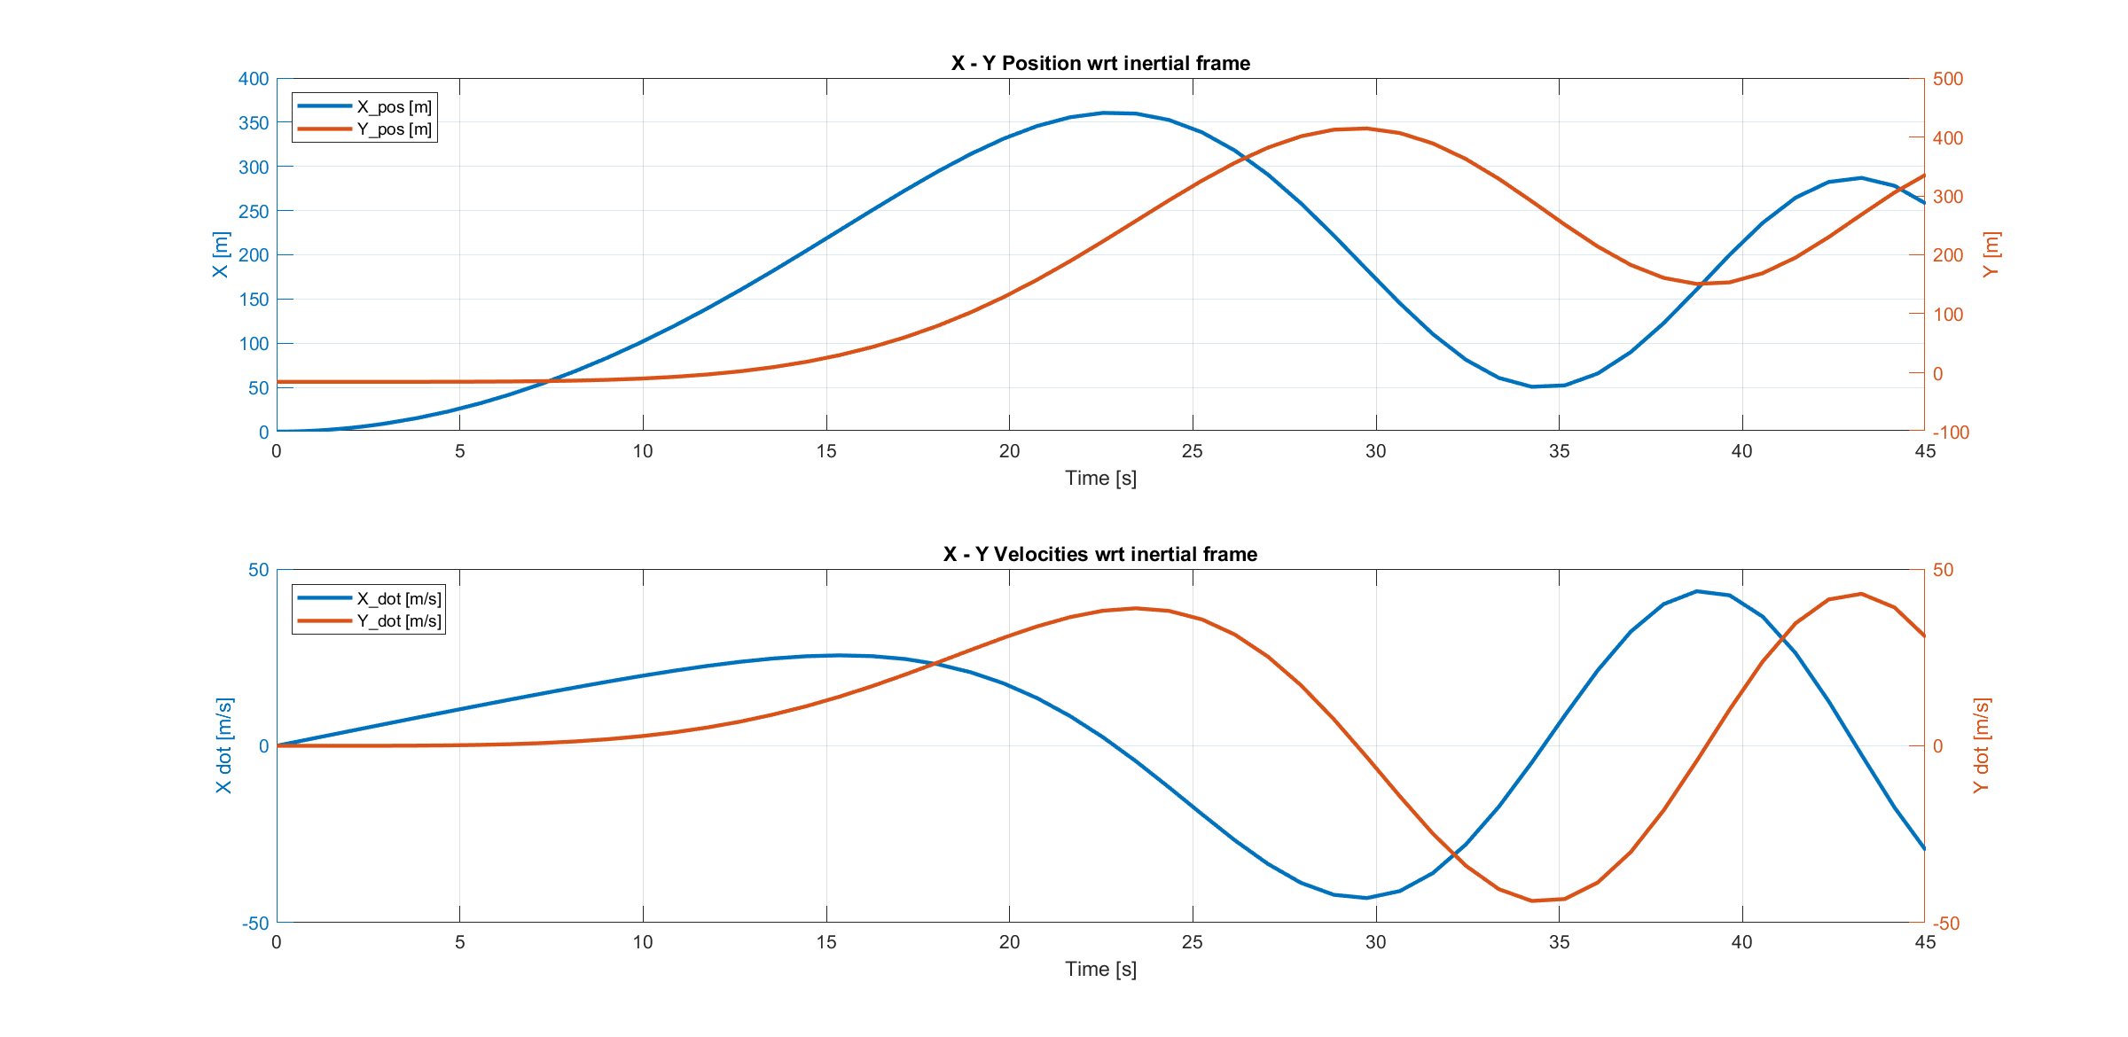
Constant steer and increasing velocity path
Simulation 5

Slide 40
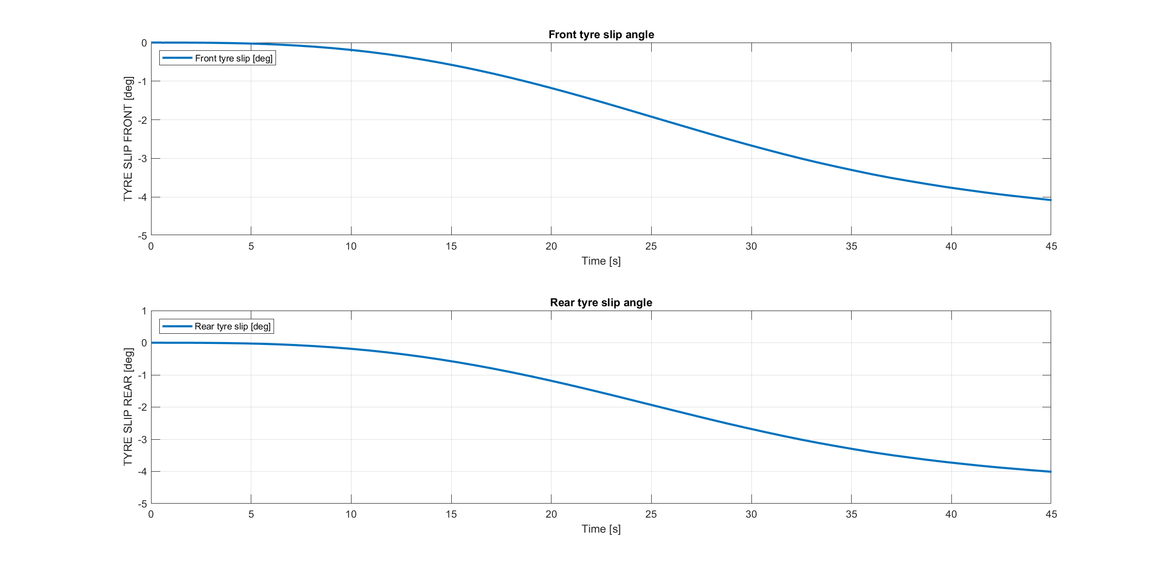
Constant steer and increasing velocity path
Simulation 5

Slide 41
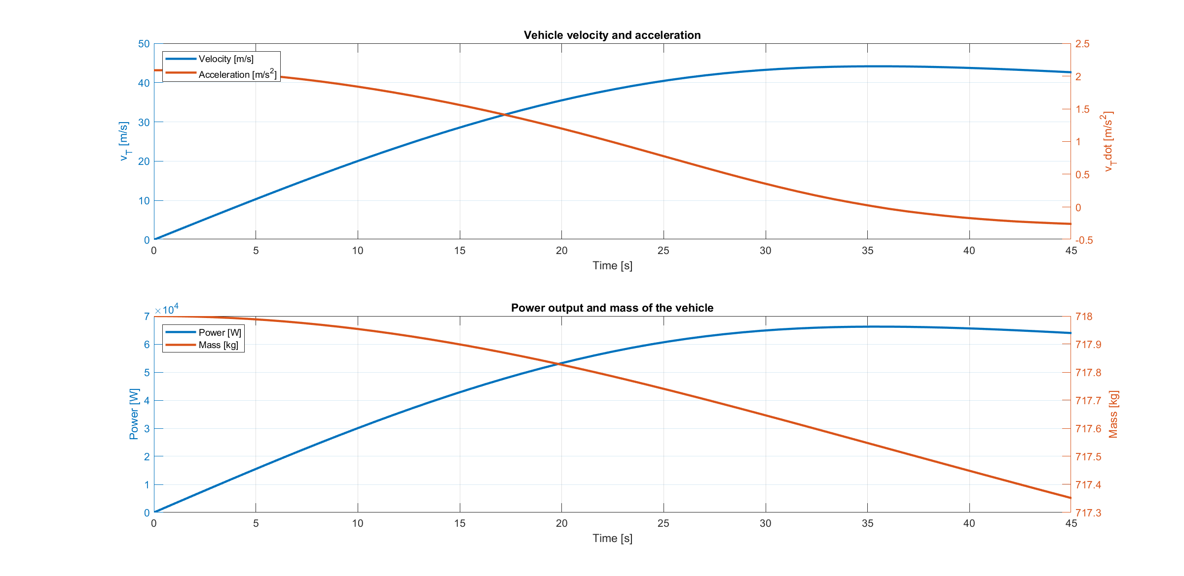
Constant steer and increasing velocity path
Simulation 5

Slide 42
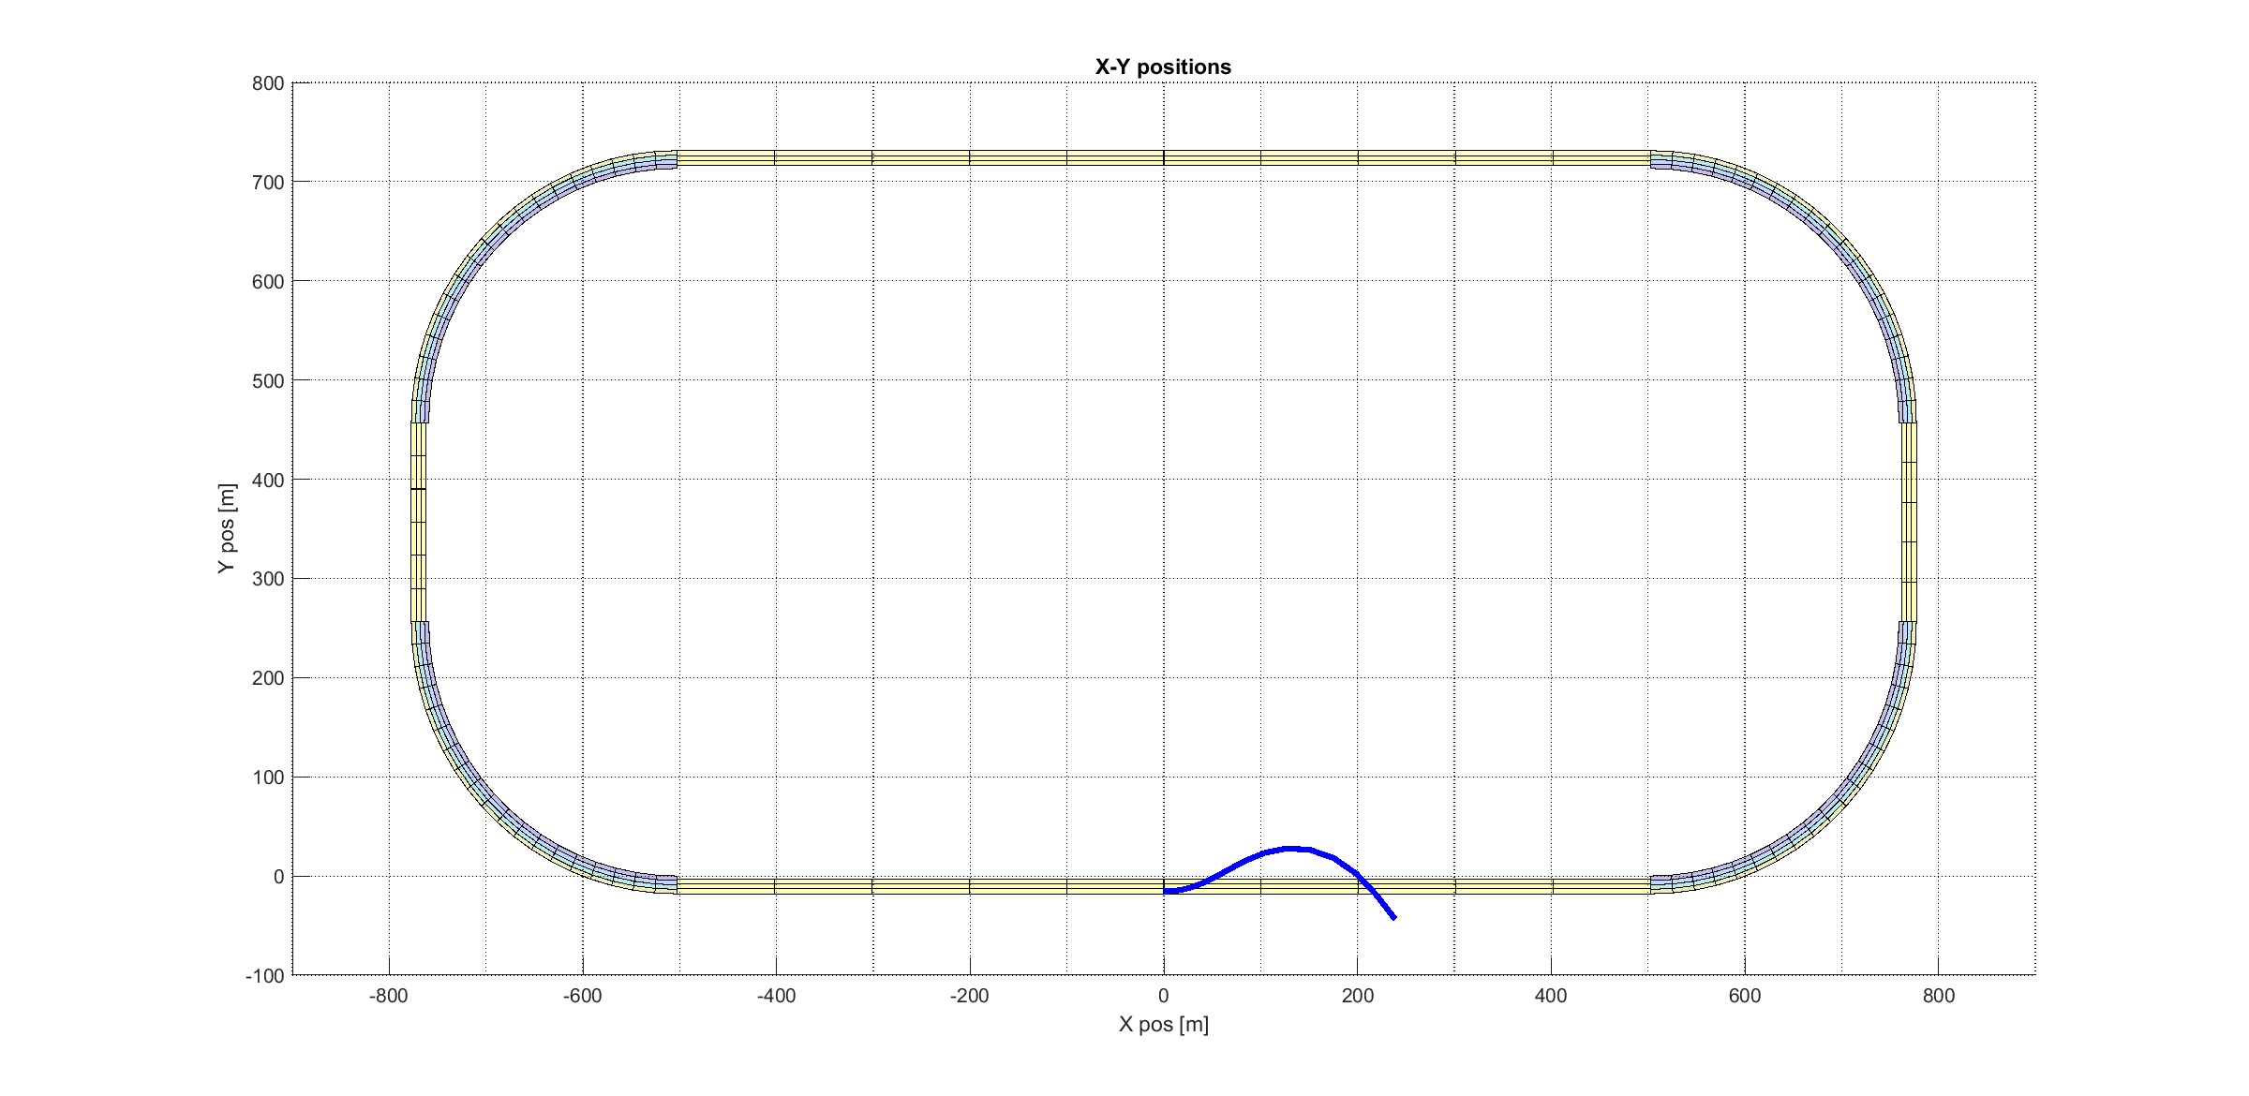
Sinusoidal wave path
Simulation 6

Slide 43
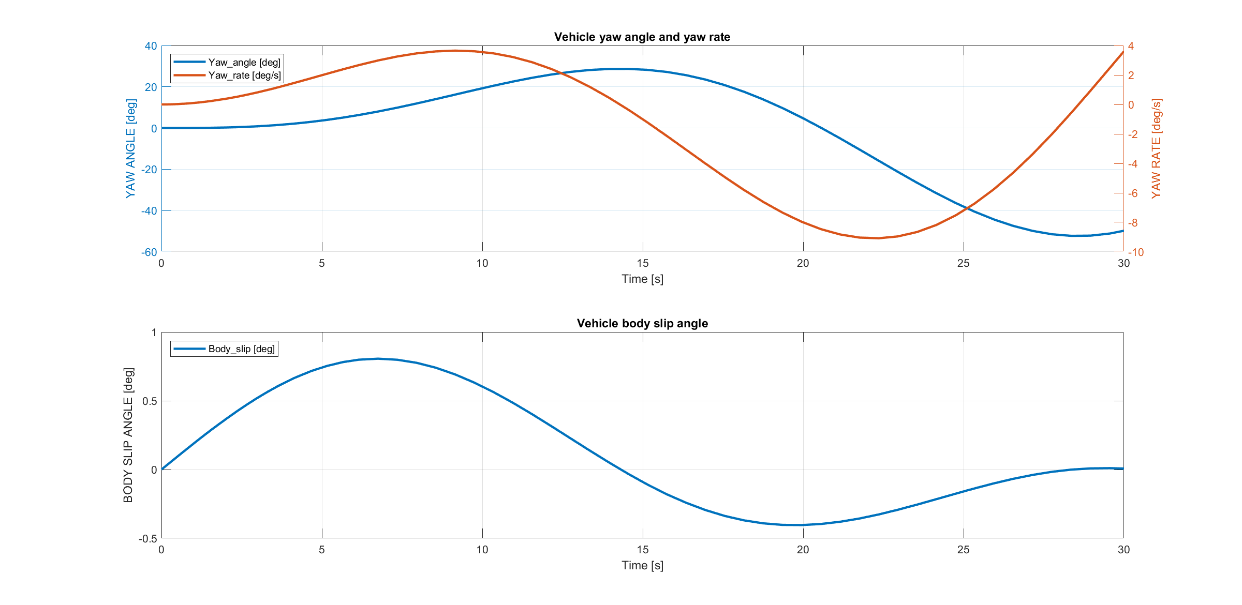
Sinusoidal wave path
Simulation 6

Slide 44
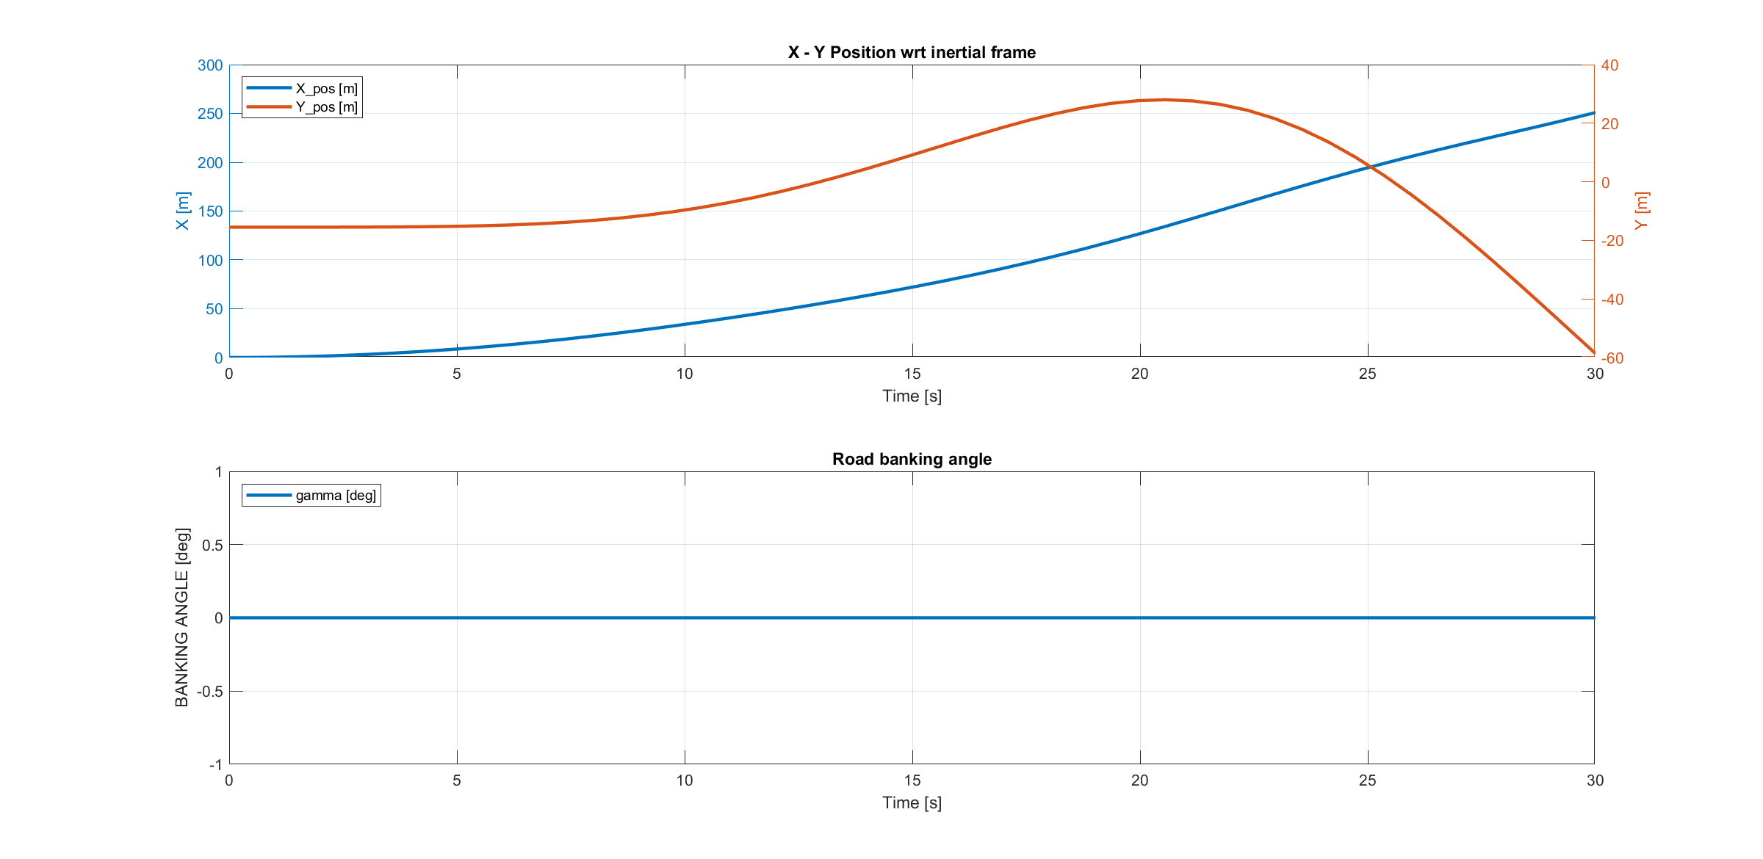
Sinusoidal wave path
Simulation 6

Slide 45
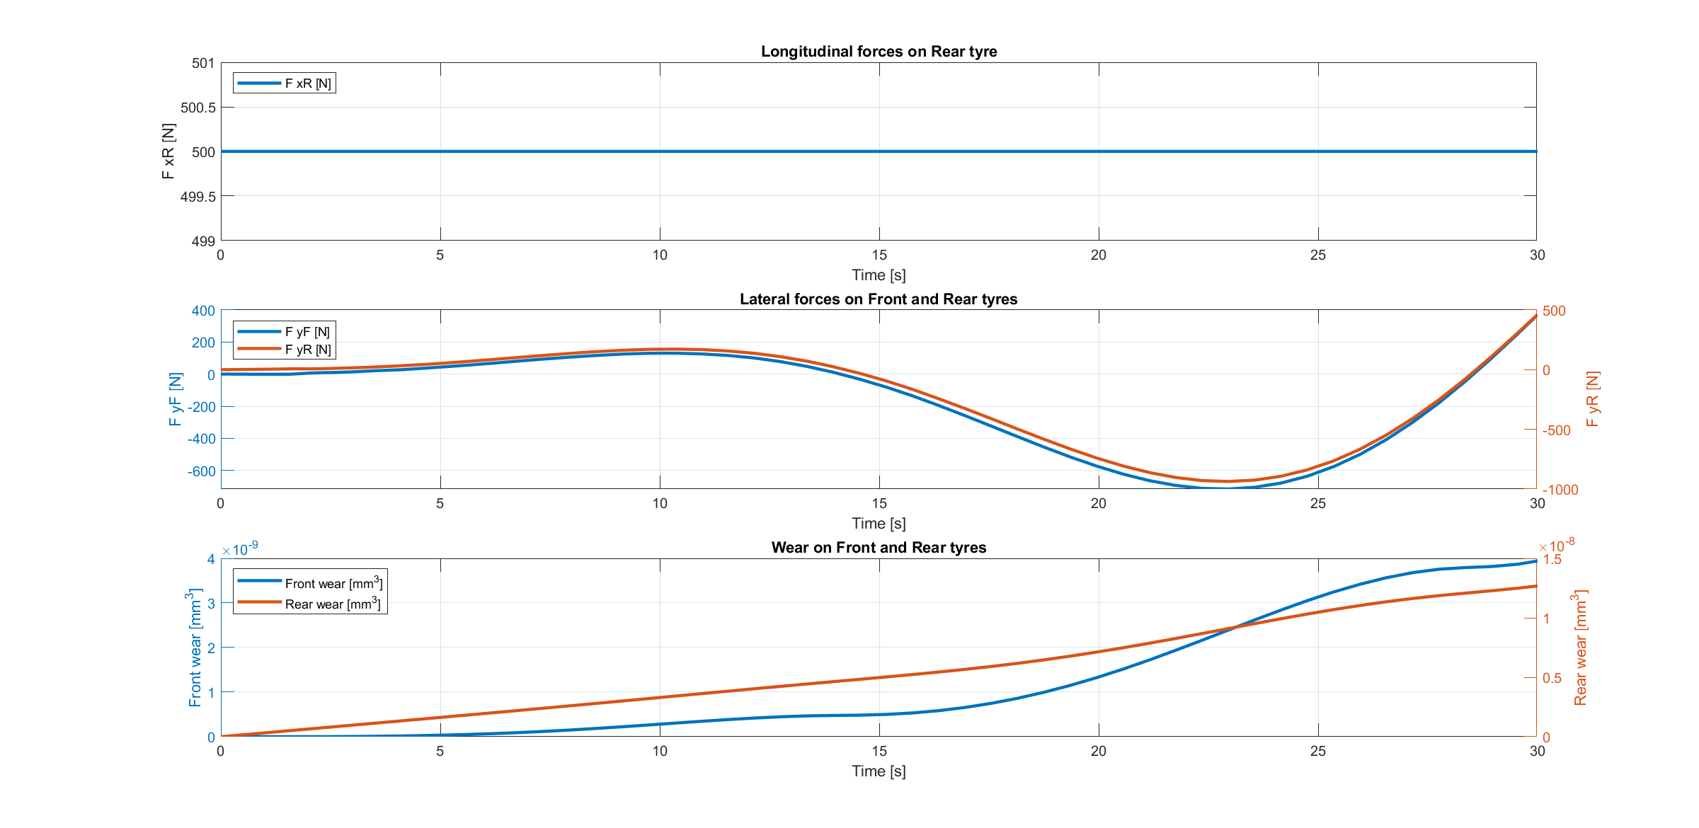
Sinusoidal wave path
Simulation 6

Slide 46
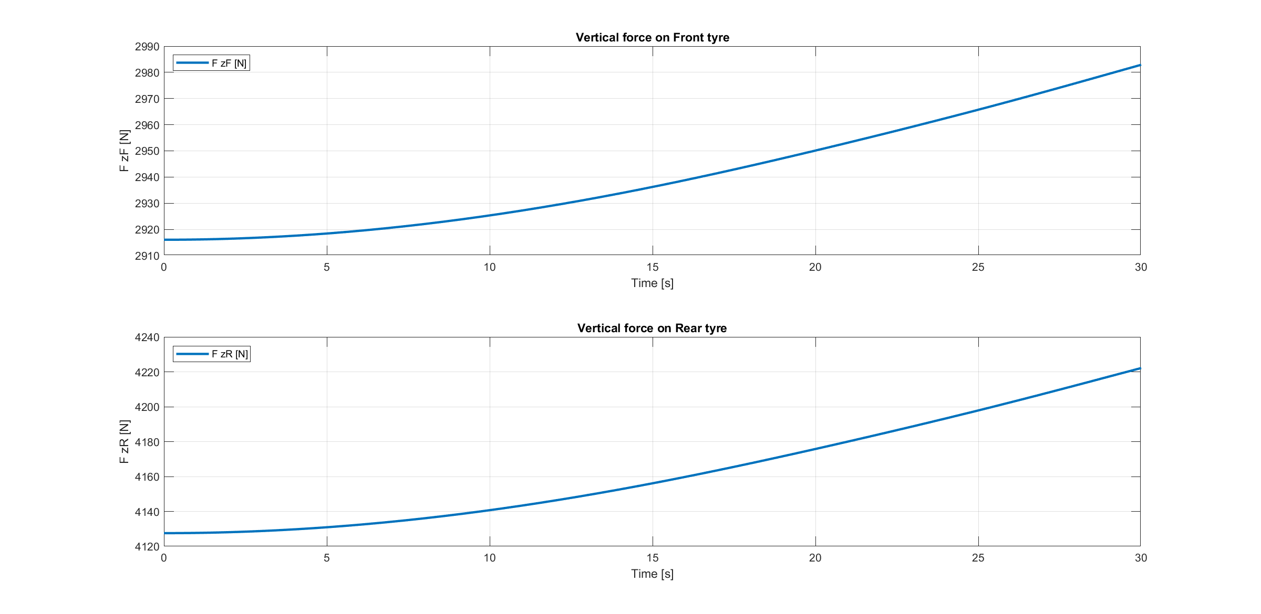
Sinusoidal wave path
Simulation 6

Slide 47
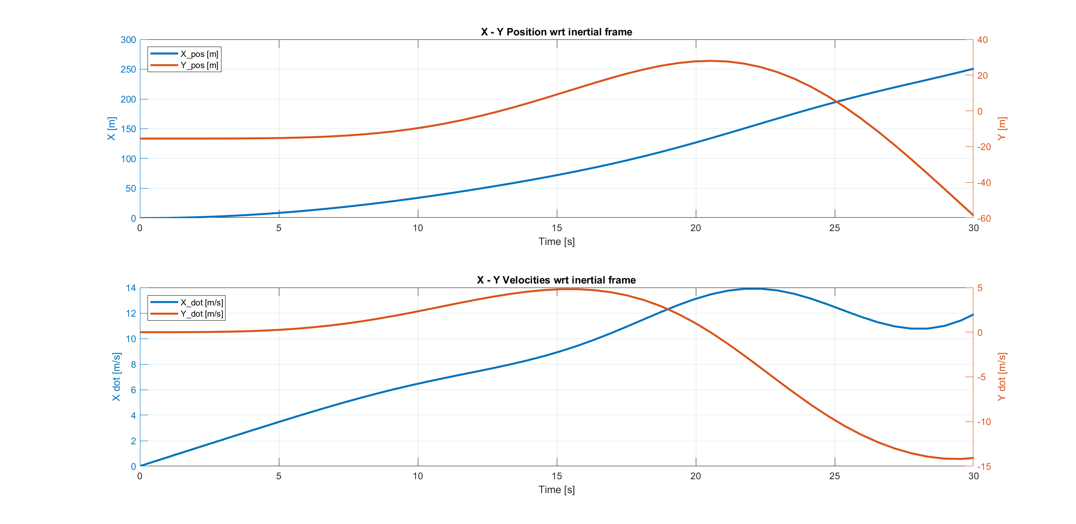
Sinusoidal wave path
Simulation 6

Slide 48
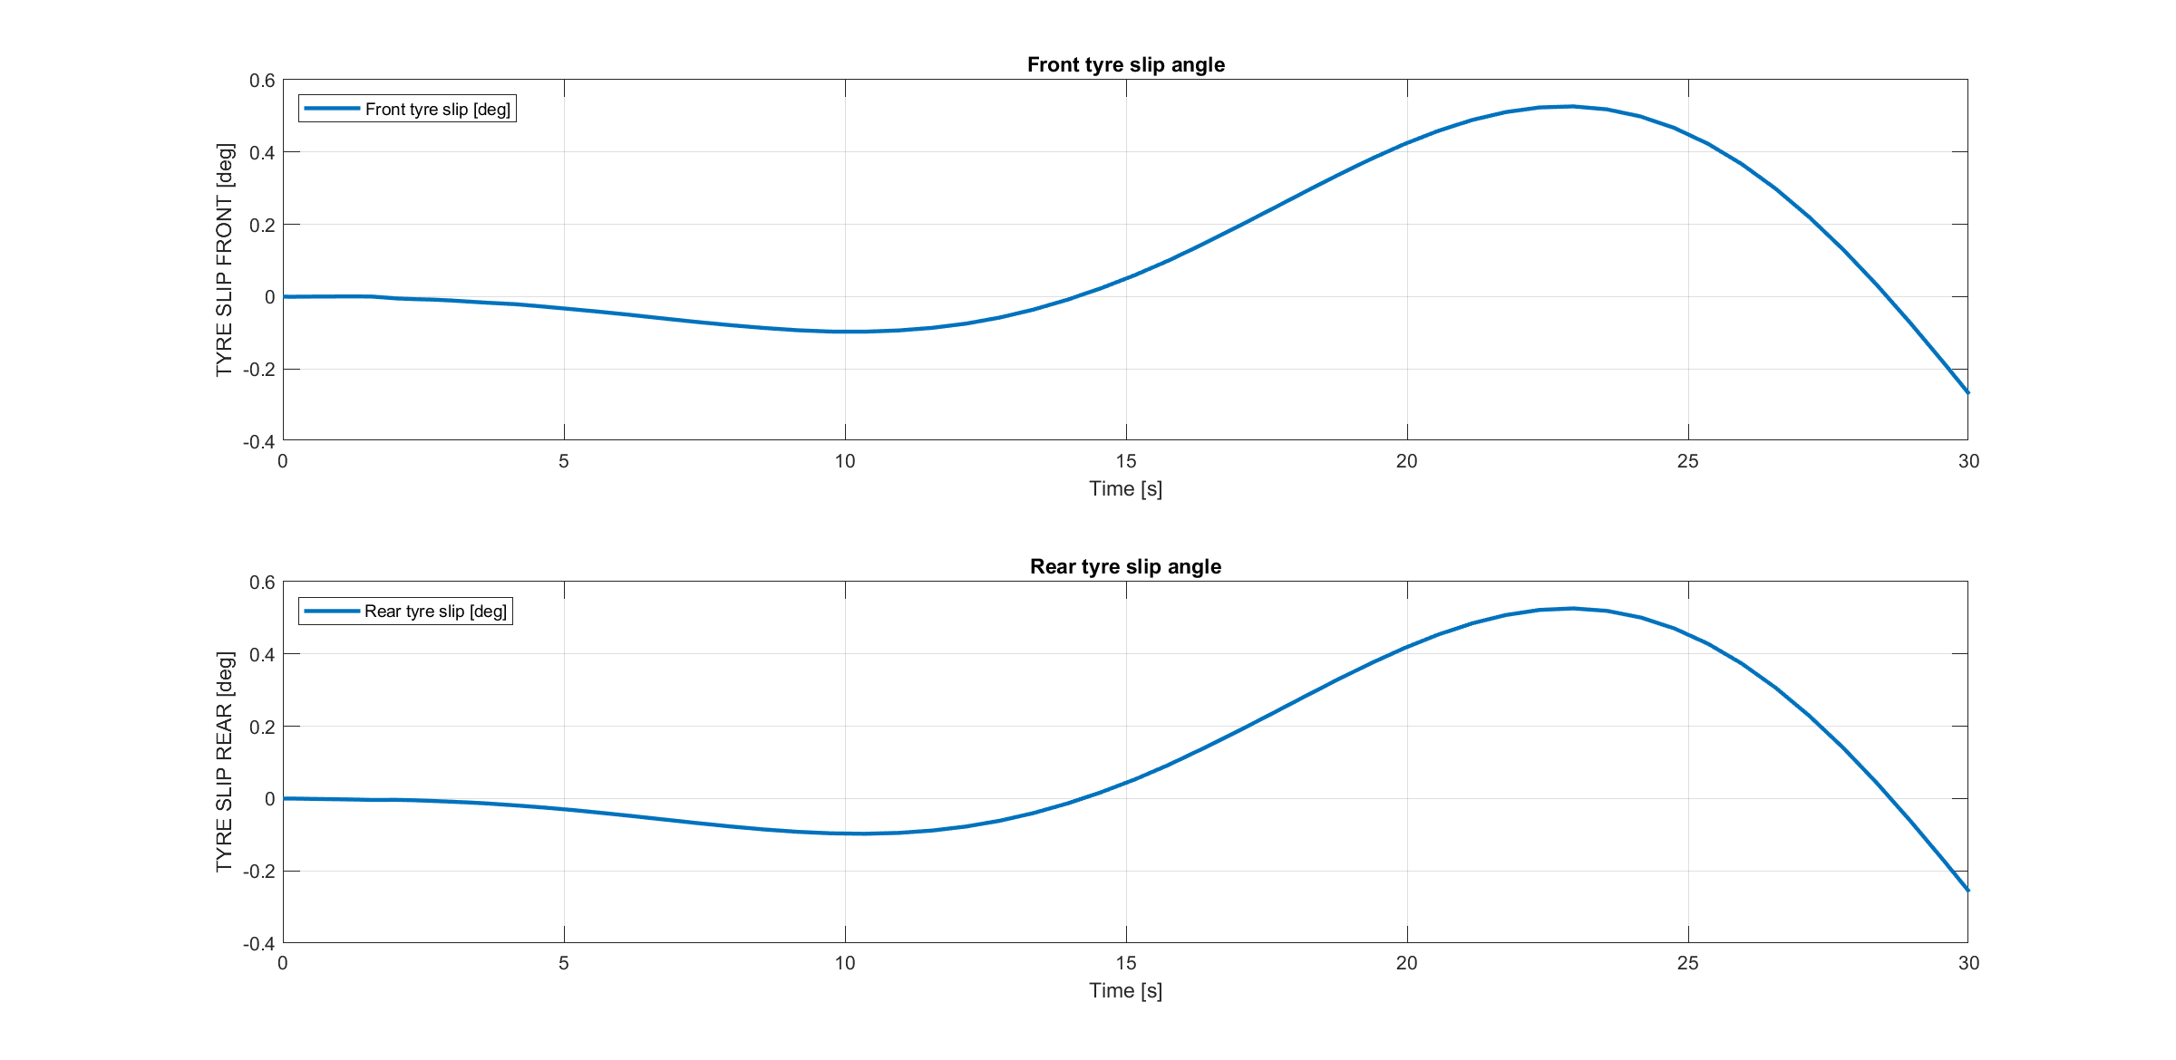
Sinusoidal wave path
Simulation 6

Slide 49
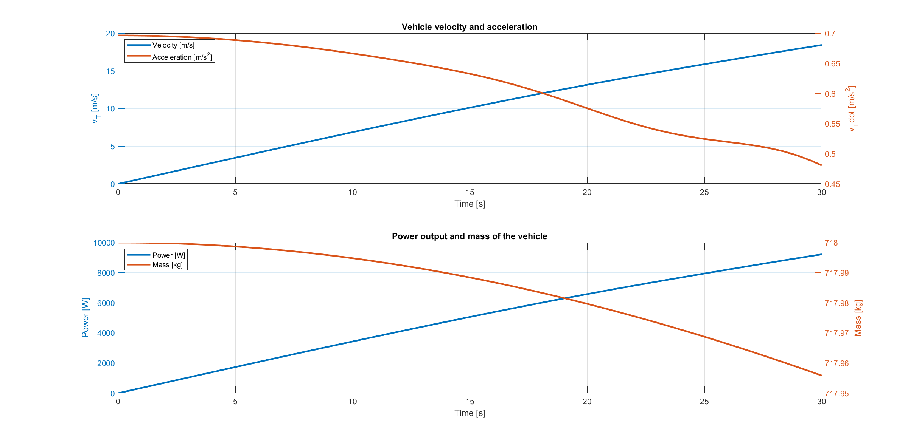
Sinusoidal wave path
Simulation 6

Slide 50
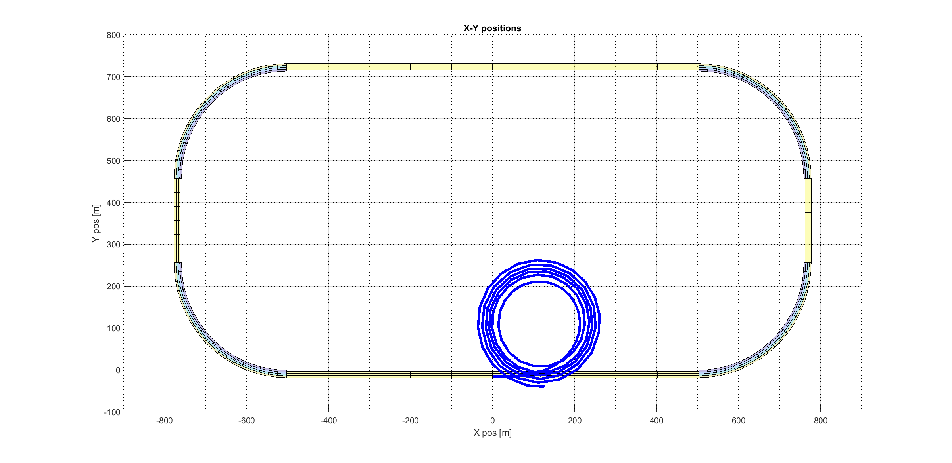
Constant speed and increasing steering angle
Simulation 7

Slide 51
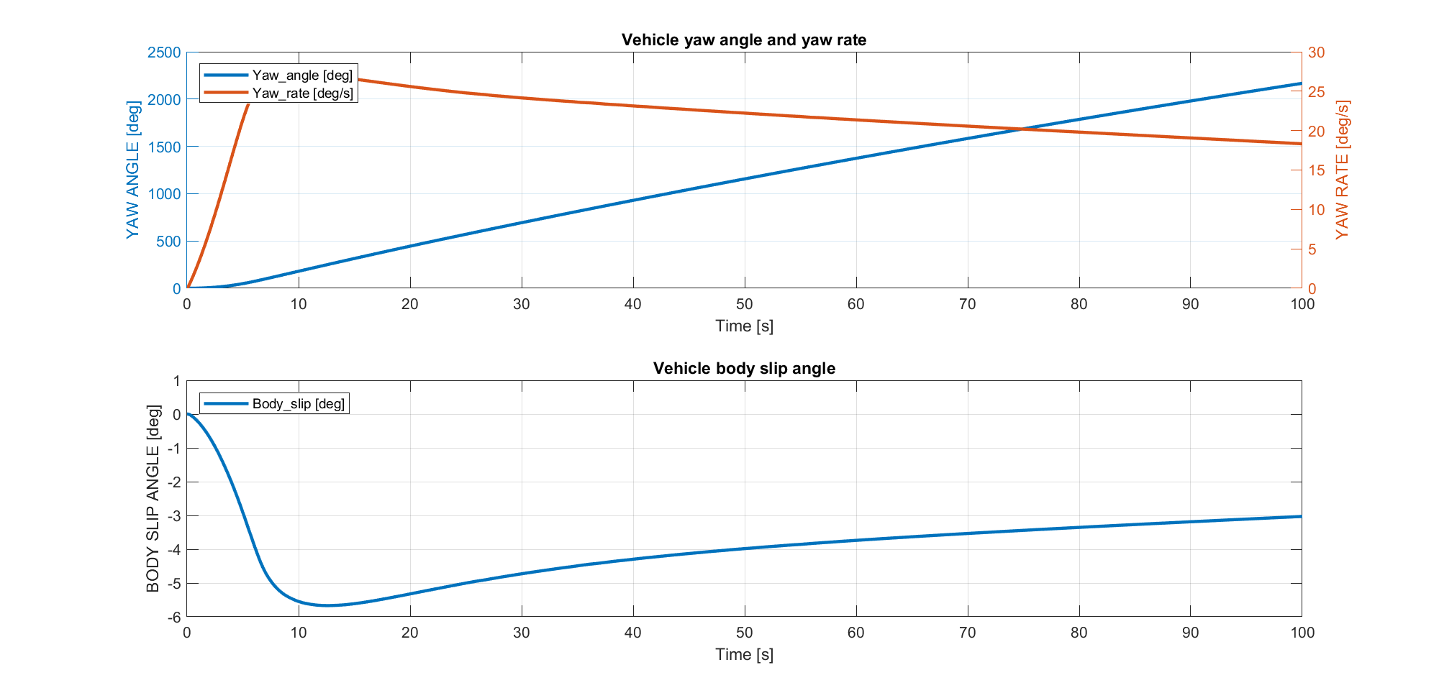
Constant speed and increasing steering angle
Simulation 7

Slide 52
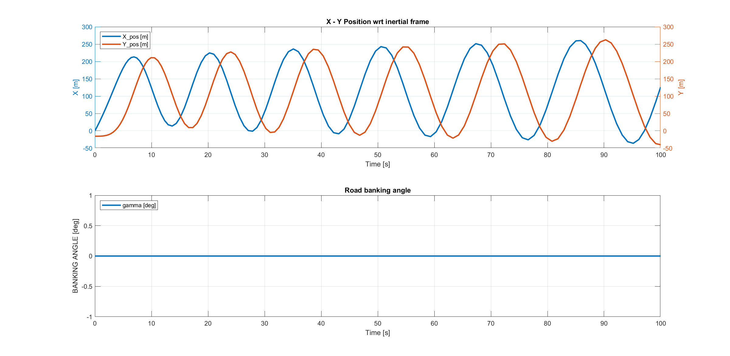
Constant speed and increasing steering angle
Simulation 7

Slide 53
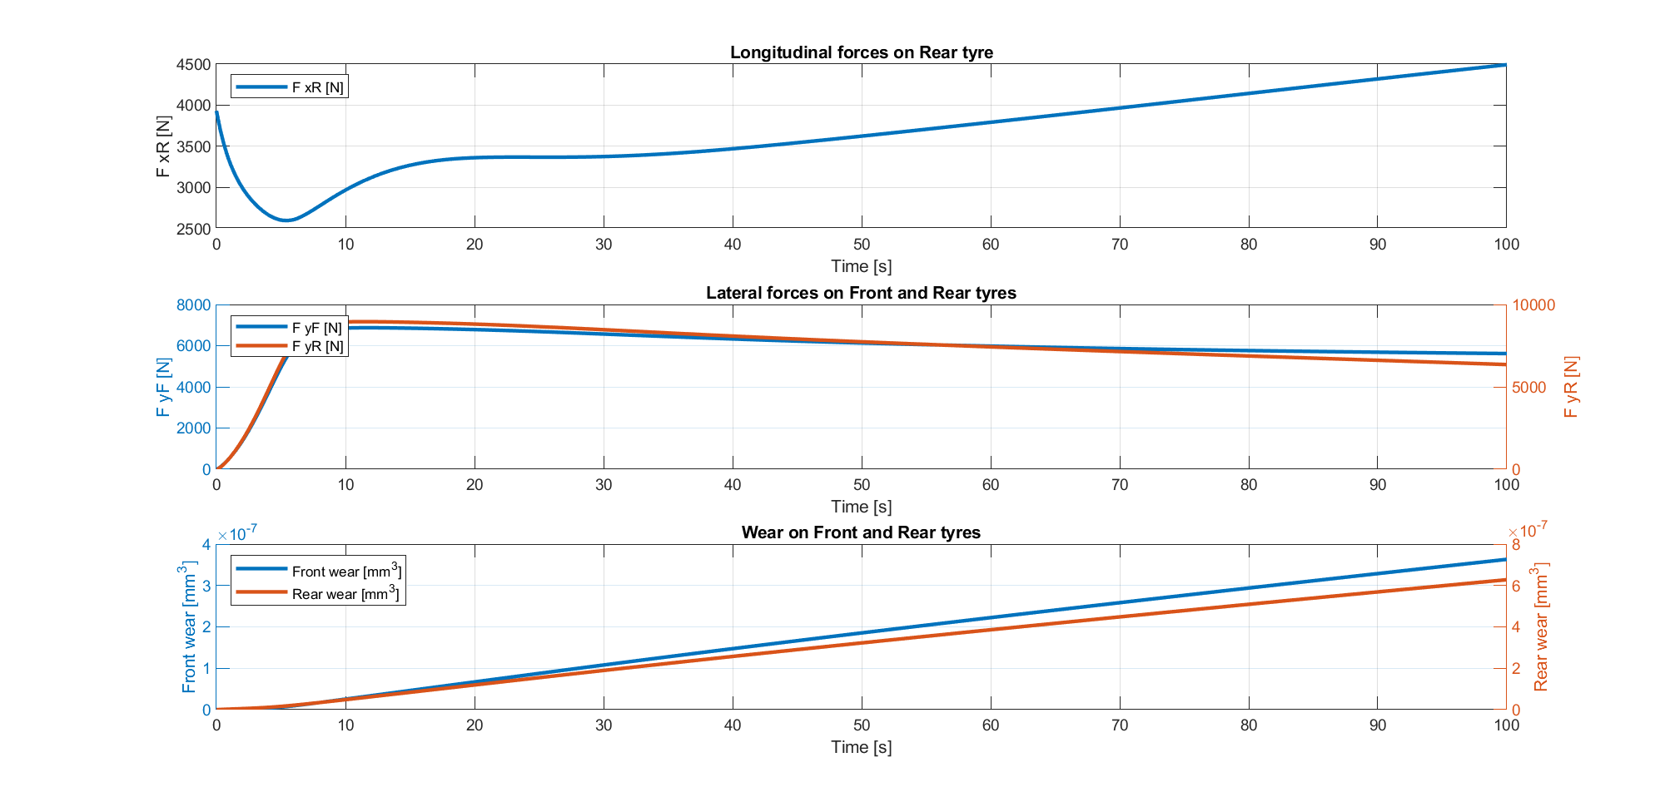
Constant speed and increasing steering angle
Simulation 7

Slide 54
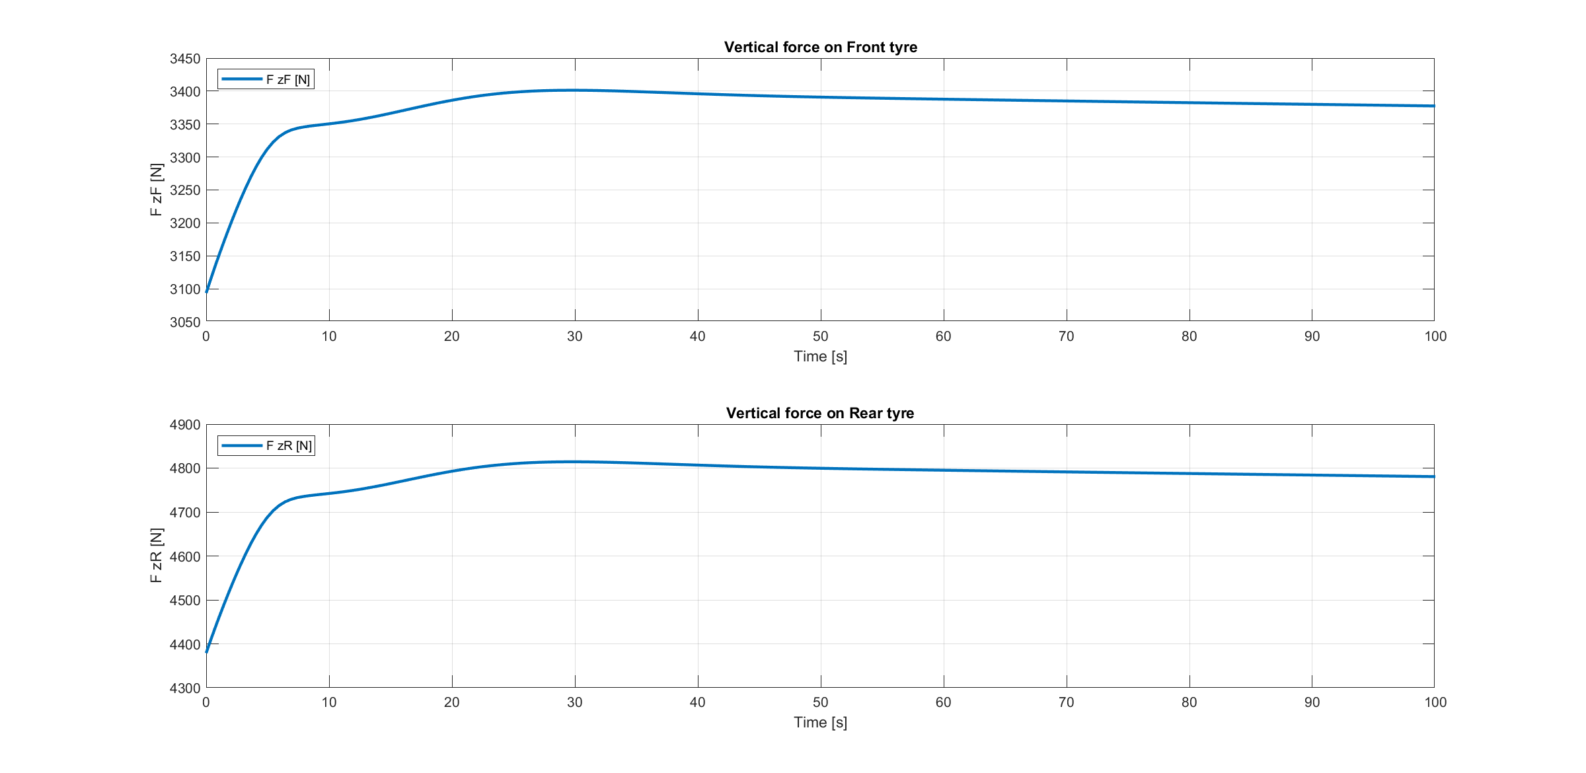
Constant speed and increasing steering angle
Simulation 7

Slide 55
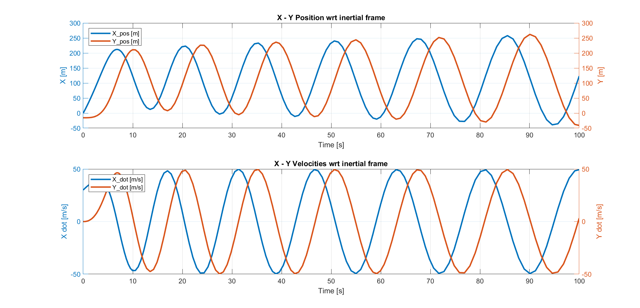
Constant speed and increasing steering angle
Simulation 7

Slide 56
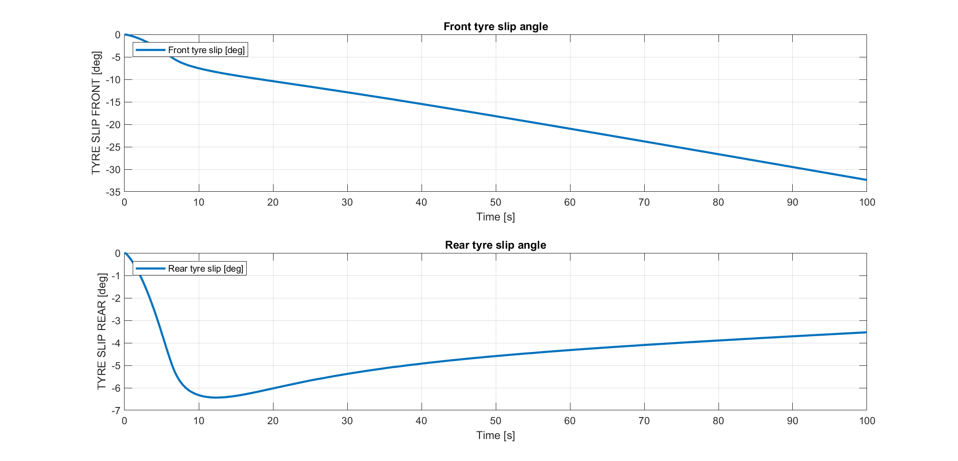
Constant speed and increasing steering angle
Simulation 7

Slide 57

Constant speed and increasing steering angle
Simulation 7

Slide 58
Thanks!
-Simulation results-

